Slide 1
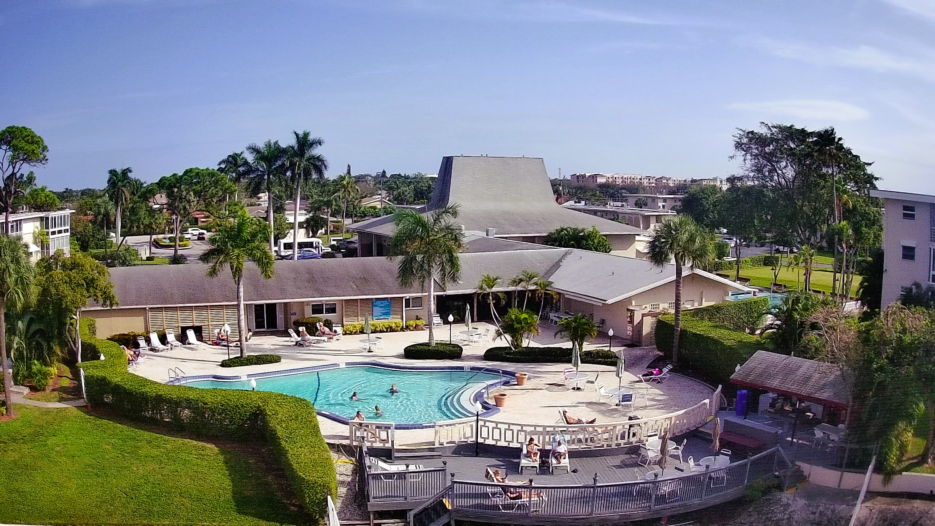
Lake Clarke Gardens Association

Slide 2
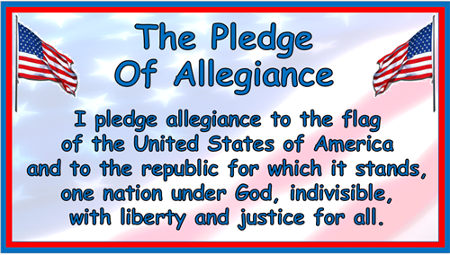

Slide 3
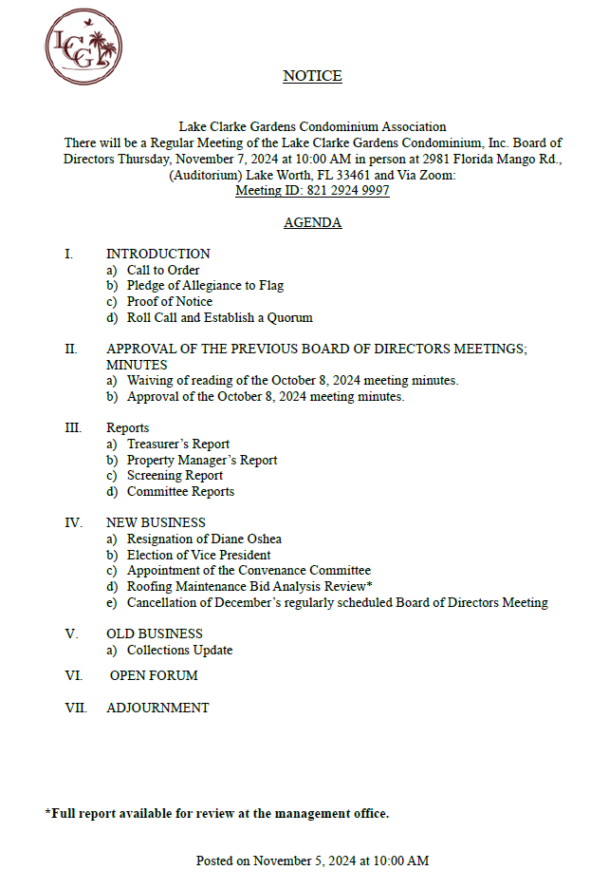

Slide 4

TREASURER’S REPORT
October 2024

Slide 8
MANAGER’S UPDATE
SIRS
AUDIT
ACTION LIST
ELEVATOR INSPECTION
BULK TRASH
PENDING PROJECTS

Slide 9
Marilyn Herrera
2616 N Garden Drive 202
9-202
Rita Gonzales and Steven George
2855 S Garden Drive 107
24-107
LCG RE-SALE

Slide 10
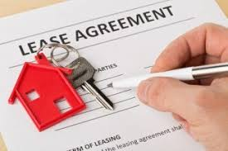
LCG APPROVED LEASES
October 9, 2024-November 6, 2024
14-205
3-107
7-201
8-305
4-210
8-301
22-304

Slide 11

COMMITTEE REPORTS

Slide 12
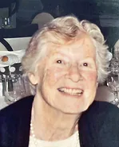
Diane O’Shea
As a board member and supporter of Lake Clarke Gardens, you have generously given your time to make tough decisions and act in the best interest of LCG. Thank you for dedication all these years.
Board of Directors

Slide 13

Appointment of Vice President

Slide 14

Appointment of the Covenant Committee

Slide 15
ROOF MAINTENANCE AND REPAIR
Proposal Comparison Spreadsheet
 | PSI ROOFING | OMEGA ROOFING | CROWTHER
Price | $330,066.00 (Discount $17,361.00) | $327,950 | $28,605.00
Contractor information | 792 NE 45th St., Oakland Florida 3334 | 9190 NW 119th St. , Unit 3 Hialeah Gardens, FL 33018 | 15865 Assembly Loop Rd. Jupiter, FL 33478
Phone Number and Email | 954-791-7663 | 954-464-8699 | 561-624-9189
Licensed, Bond, and Insured | License No. CCC047136 Certificated Roofing Contractor License No. CGC047136 Certified General Contractor | License No. ccc057472 Certified Roofing Contractor | License No. CCC039822 Certified Roofing Contractor
Years of Service | 30 years | 29 years | 28 years
Scope of Proposal | Roof Maintenance, Gutter Inspection, repairs and replacement as needed. Removing and replacing pitch pans as needed. Waterproofing and sealing of all HVAC racks, vents, M-Curbs, flashing ext. Apply fibered coating to exposed mastic. Metal flashing repair and replacement were needed, Removal of debris and cleaning of roof. | Vertical seems will be checked and repaired. Spot repair where needed. Flashing will be repaired and checked. Drains will be cleaned and sealed. Roof will be cleaned and cleared of debris. | Roof Maintenance. Repair only the roofs that issues have been identified with.
Material / Method of repairs | Method-Torch down roofing which requires an open flame propane torch for the installation of sheets of modified bitumen. Seams are then melted to create a water tight seal. Material-concrete water proofing, Plastic cement, Asphalt roof primer, Aluminum roof coating, Polyurethane Sealant, Gaco Silicone Roof Coating. GacoRoof Self‐Adhesive Seam Tape | Method-Patch. Materials-Roofing Cement and Karnak Asphalt coated tape. (not recommended for the repairs of blisters as they must be cut, dried, recovered with a base sheet and cap sheet, then sealing of the edges. | Material list not provided.
Lead Time | One week | One Week | One Week
End Date | TBD | TBD | TBD
Payment Requirement | 20% | 50% | 50%
Warranty | I year warranty | 2 year Warranty | 1 year warranty
Notes | The vendor has an Engineer on site for three weeks to complete a full evaluation of our roofs. The inspection was done at a savings of $12,500.00 as the fee was waived. The proposal was comprehensive and included all repairs. Letter provided extending the life of the roof. | The vendor did not come onsite to inspect all of the roofs. They opted to complete the inspection with satellite imagery. The inspection was done at not charge. The proposal was not comprehensive when compared to PSI. No letter provided. | The vendor was onsite to do the inspection. The association was charged for the inspection at a cost of $2,500.00. The inspection was not as comprehensive as PSI and they will charge for repairs as they are recognized. All repairs are not included in the proposal. No letter provided

Slide 16
Roofing supplies for project

Slide 17


Collections Update
The overall collections for Lake Clarke Gardens had been reduced in the amount of $134,250.00 since the mailing of our letters on 9/30/2024. We will continue to monitor large balances and forward the files to collections as needed. A new set of letters will be mailed towards the end of November.

Slide 18


Slide 19
ADJOURNMENT

