Slide 1
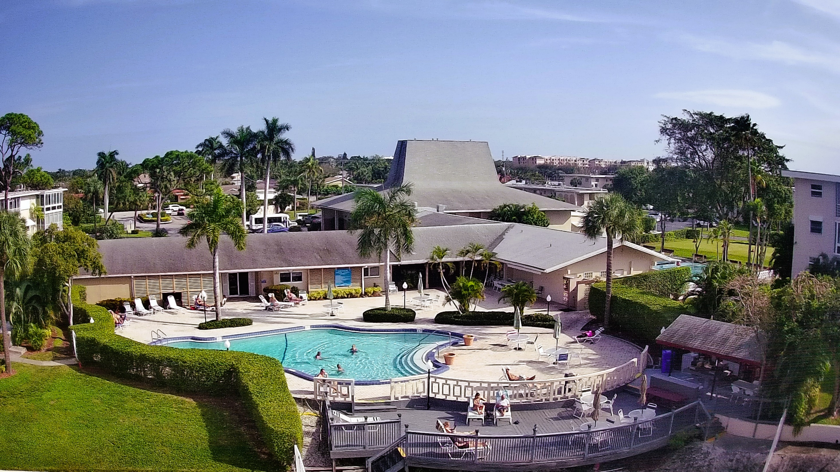
Lake Clarke Gardens Association

Slide 2


Slide 4

TREASURER’S REPORT
December 2024

Slide 5
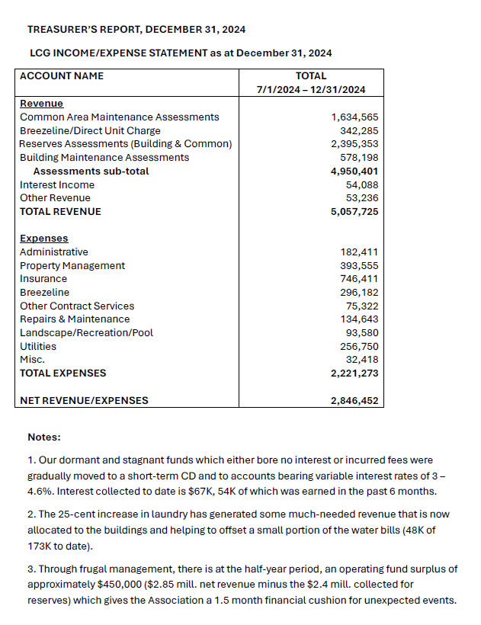

Slide 6
MANAGER’S UPDATE
UPCOMING PROJECTS
POOL SIGN
AUDIT
YEAR
END
SUMMARY

Slide 7
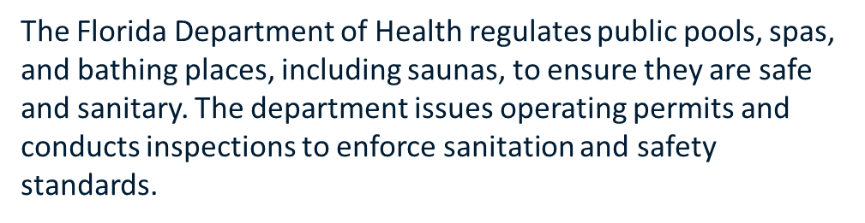
In Florida, public swimming pools can't be open at night unless they have proper lighting and the local building department approves it. The Florida Department of Health's Environmental Health Division doesn't specify hours for community pools, but state codes regulate them.
Night swimming regulations
Lighting: Pools must have proper lighting for safety. This includes underwater and overhead lighting.
Lighting plan: The lighting plan must be approved by the local building department after a professional conducts a field inspection.
Pool permit: The pool permit will note if the pool is approved for night swimming.
Pool hours: Pool hours must be posted on the rules sign.
Public Swimming Pools | Florida Department of Health
Florida Department of Health (.gov)
https://www.floridahealth.gov › environmental-health
Then, "night swimming approved" will be noted on the pool permit. State code defines night swimming as 30 minutes before sunset to 30 minutes after sunrise.

Slide 8
Chapter 514 as it will look following HB 1263 514.011
(1) Definitions. – As used in this chapter: “Department” means the Department of Health.
(2) “Public swimming pool” or “public pool” means a watertight structure of concrete, masonry, or other approved materials which is located either indoors or outdoors, used for bathing or swimming by humans, and filled with a filtered and disinfected water supply, together with buildings, appurtenances, and equipment used in connection therewith. A public swimming pool or public pool shall mean a conventional pool, spa-type pool, wading pool, special purpose pool, or water recreation attraction, to which admission may be gained with or without payment of a fee and includes, but is not limited to, pools operated by or serving camps, churches, cities, counties, day care centers, group home facilities for eight or more clients, health spas, institutions, parks, state agencies, schools, subdivisions, or the cooperative living-type projects of five or more living units, such as apartments, boardinghouses, hotels, mobile home parks, motels, recreational vehicle parks, and townhouses.
(3) “Private pool” means a facility used only by an individual, family, or living unit members and their guests which does not serve any type of cooperative housing or joint tenancy of five or more living units.

Slide 9
2024 Year End Summary
Completed Projects-84
LCG Work Orders (As of March-1, 2024)1,310
Seacrest Work Orders- 173
Leaks and Drywall Repairs-57

Slide 10
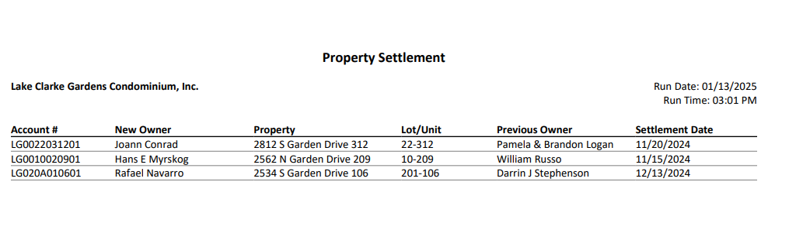
LCG RE-SALE
Elmer Hillukka and Helen Hillukka
2770 S. Garden Dr., Unit 305
21-305 (01/13/2025)

Slide 11

LCG APPROVED LEASES
November 7, 2024-January 13, 2025
2-202
7-301
7-307
8-302
10-303
10-310
10-311
12-101
12-304
16-311
20B-305
22-101
24-101
26-208

Slide 12

COMMITTEE REPORTS

Slide 13


Slide 14


Slide 15

Parking Audit
Illegal numbering of spaces
Painting parking numbers
Upcoming project (Decals)
Parking enforcement

Slide 16

Maximum of two items per unit per week
Contact the office for scheduling
$100.00 pick up charge to building for items left in common area unclaimed

Slide 17
Draft Records Request Policy And Procedures
Introduction
In acknowledgement that every member is entitled by law to inspect official records of the Association as specified in ….. and to ensure that requests to do such are received and responded to as per F.S. 718.112( ), the Association states the following policy and procedures as allowed to do according to F.S. 718.11 (). These rules are designed to
verify transmission and receipt of requests,
allow all owners the opportunity to access the Association’s official records,
give the office the resources (time, staff and finances) to respond to the requests that may be onerous in the normal course of operations.
Policy
Any member of the Association may upon written request, have access to the following Association records and documents:
  Governing documents
  Budgets
  Contracts
  Inspection reports (list all as specified by statute)
  Any other records as stipulated by F.S. 718.
The following documents are excluded from inspection and copying by owners:
  List as per statute
Response to request as per statute i.e. within 10 days of receipt of written request
To relieve the office of some of the burden of retrieving official records, the Association will post several of the statute-specified documents on its website which may be accessed by all owners.
Access to inspect the original records would be under the supervision of the Property Manager, with a staff member or Association officer present during such examination. No original documents are to be removed from the LCG Office. Also any changes to the documents.
6. Inspections are limited to a maximum of one 8-hour period per month per owner.
7. Members may also request copies of the afore-mentioned documents, at a reasonable fee as outlined in the Procedures, to cover the cost of retrieving and copying. What provision for electronic copies?
9. Use of the records – what is allowed and what is prohibited?
Procedures
Requests for record inspections and copies should be made in writing upon the form attached in Appendix 1, and sent via certified mail, return receipt requested to:
The Property Manager,
2981 Florida Mango Road,
Lake Worth, FL 33461.
Inspections will be held by appointment as determined by the Property Manager at the Association’s office at the above address.
The Association may charge 25 cents per page for copies in addition to administrative costs that may be incurred in copying records totaling more than 25 pages. Should payment be made prior to the making of the copies?
Appendix 1. Lake Clarke Gardens Records Request Form
Name:
Address (Building – Unit#):
Records requested (specify exact documents wanted, period covered etc.):

Slide 18
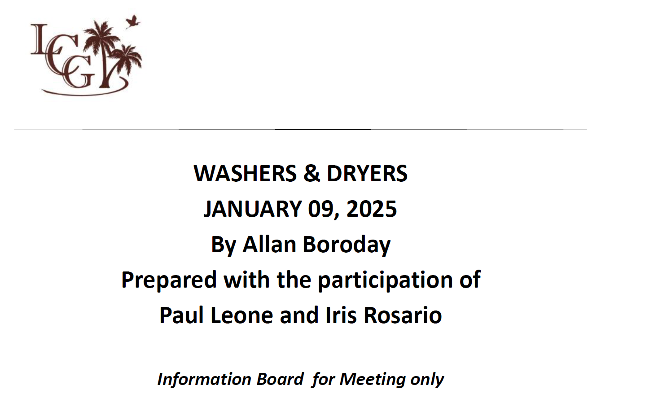

Slide 19
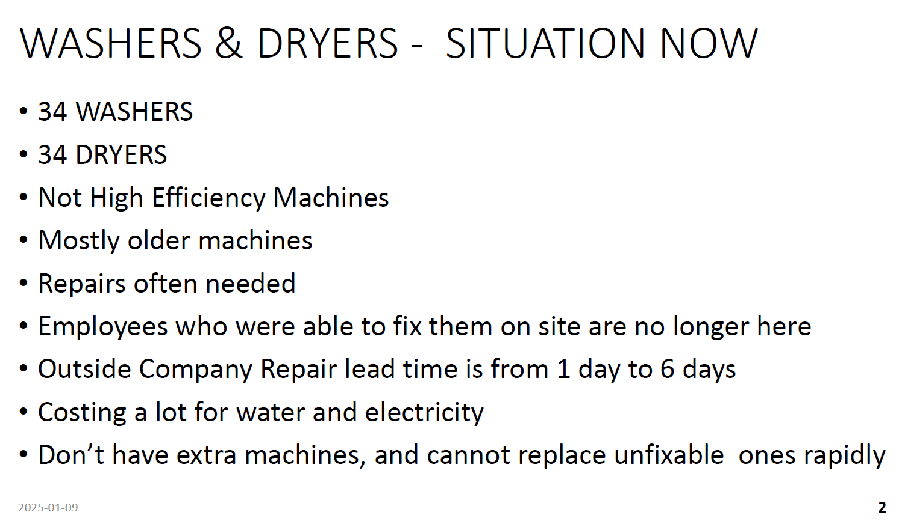

Slide 20
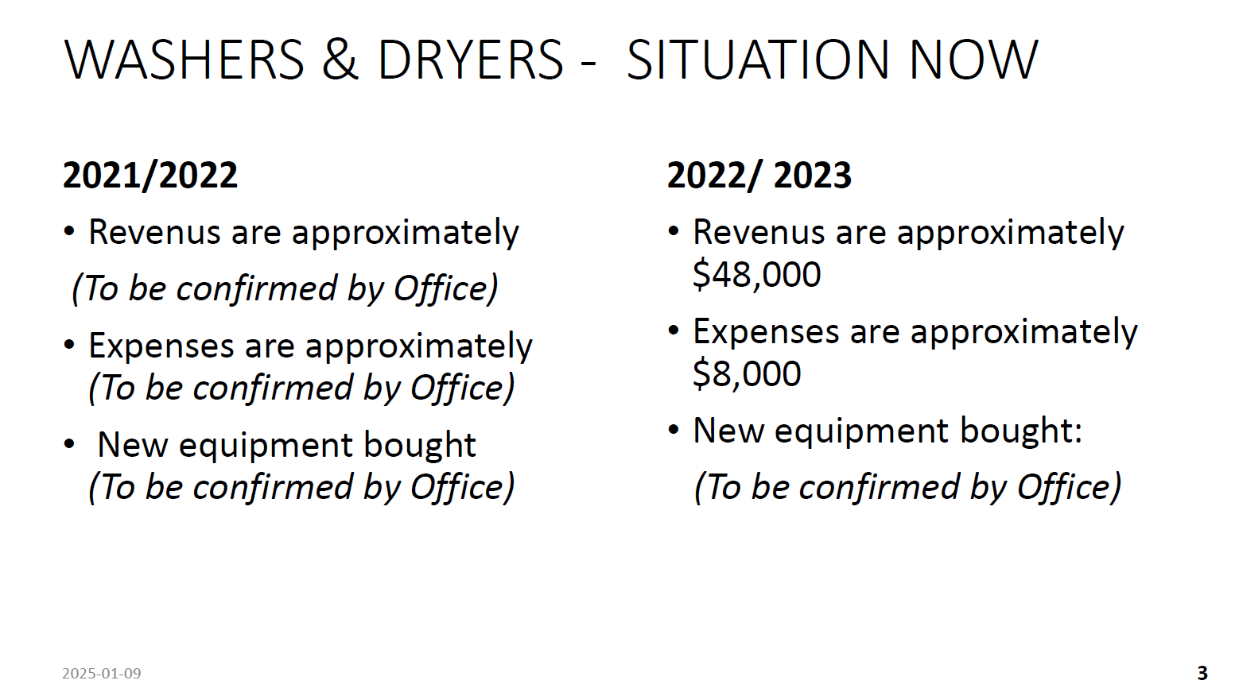

Slide 21
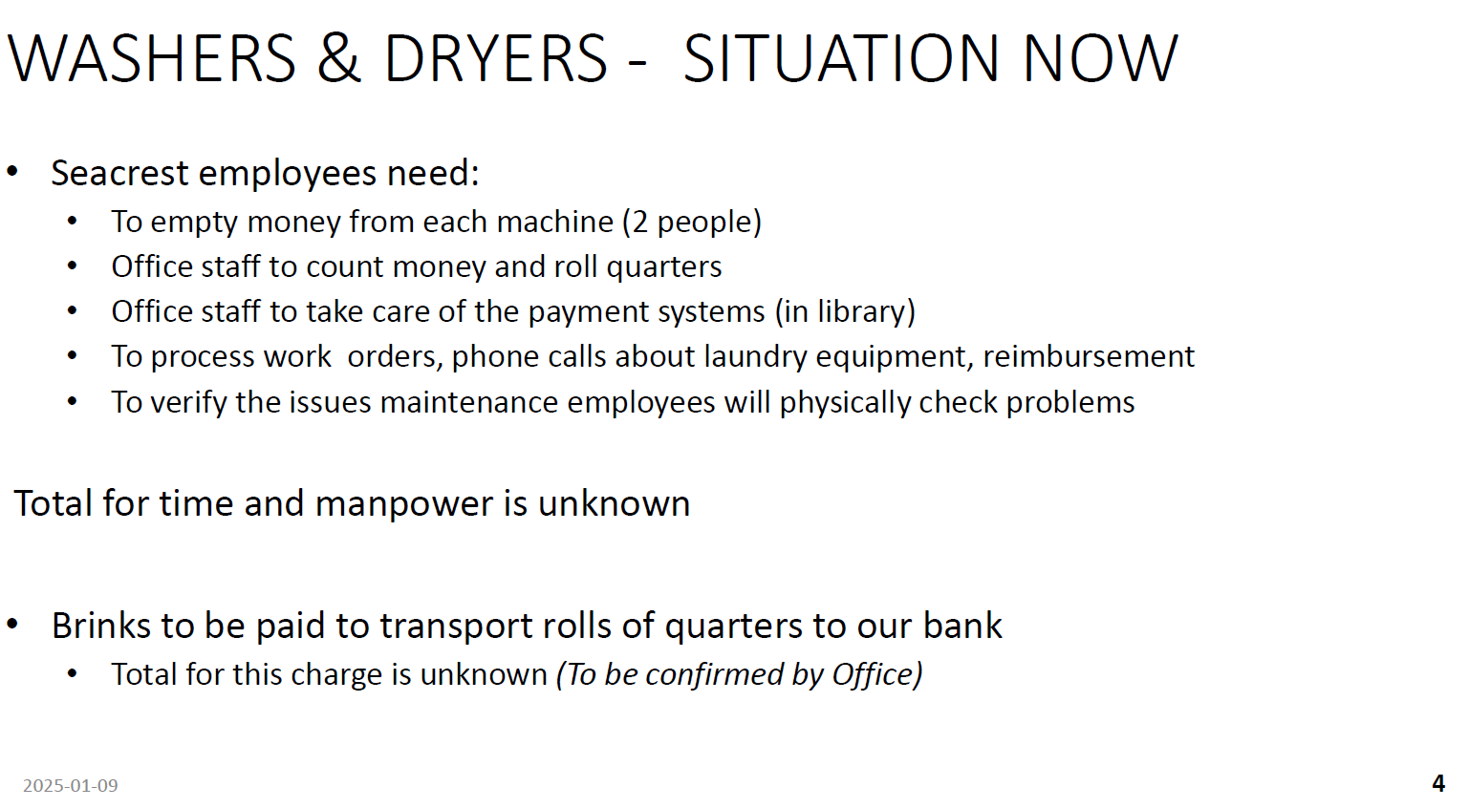

Slide 22
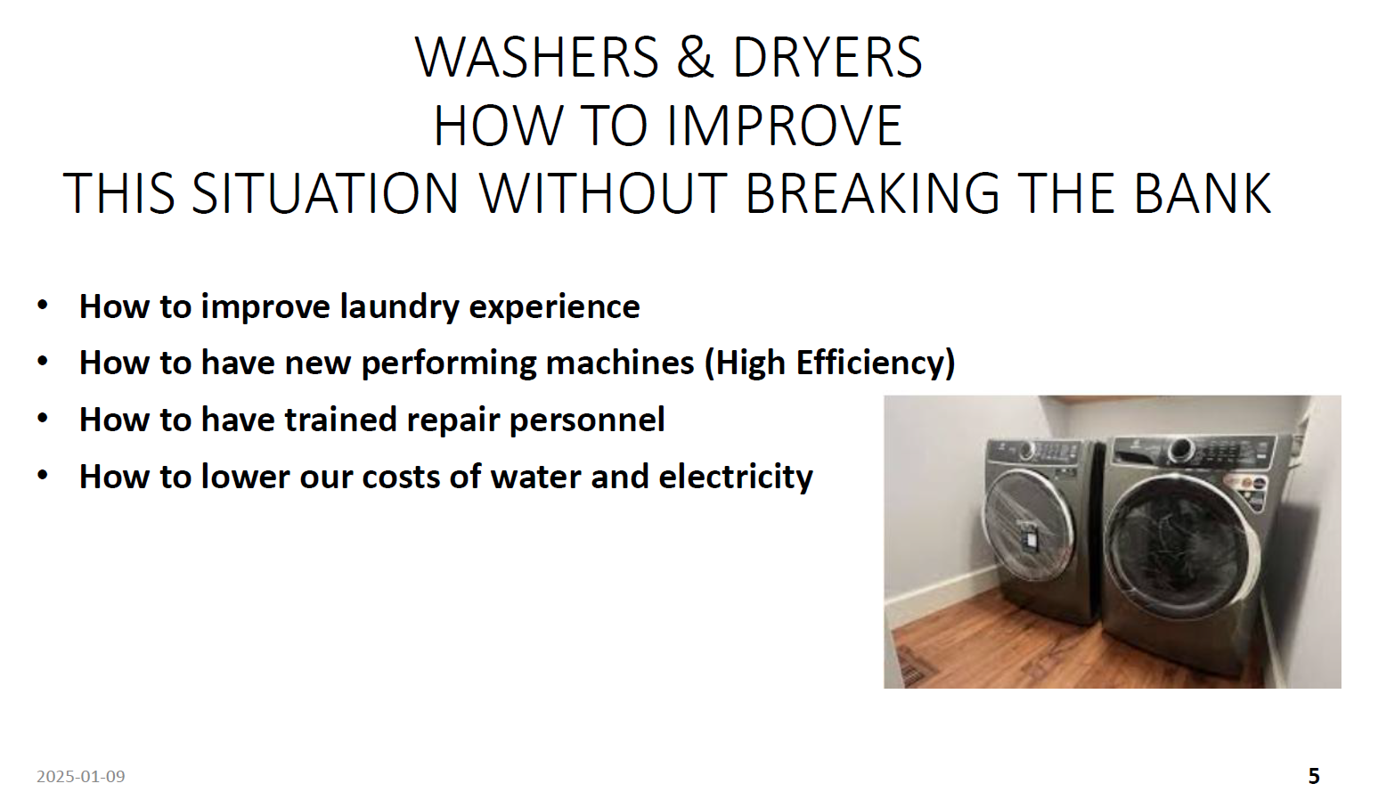

Slide 23
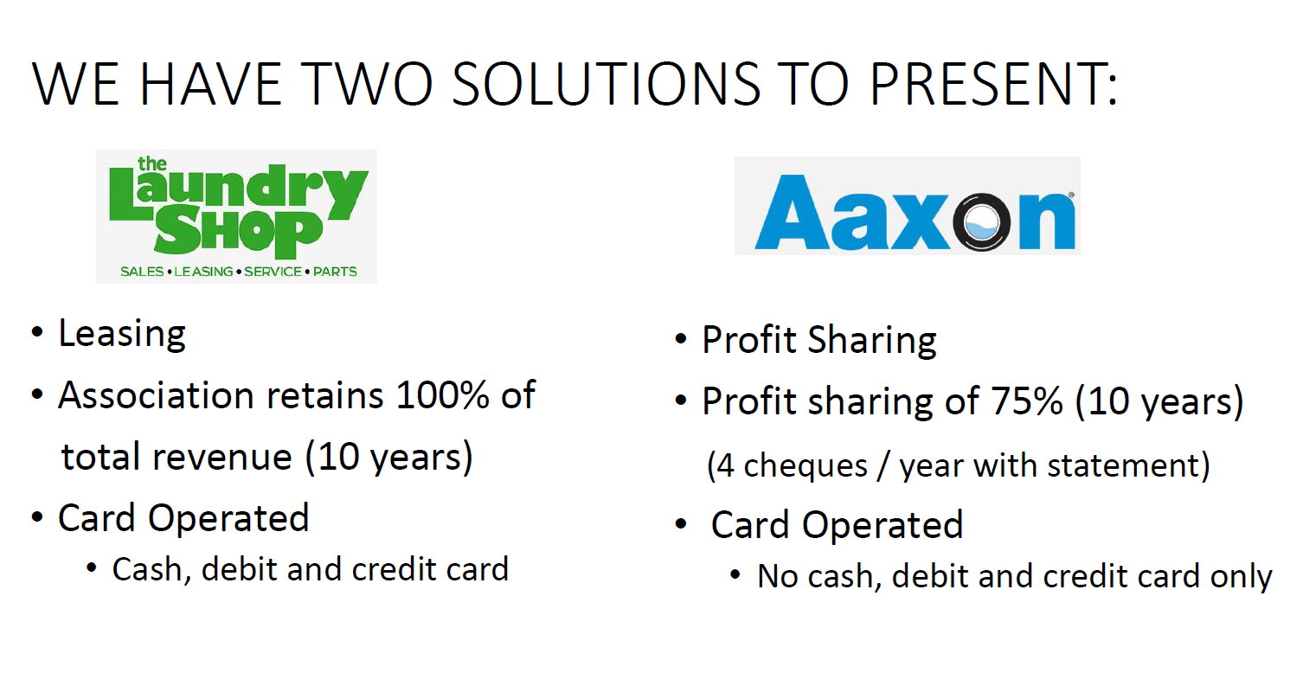

Slide 24
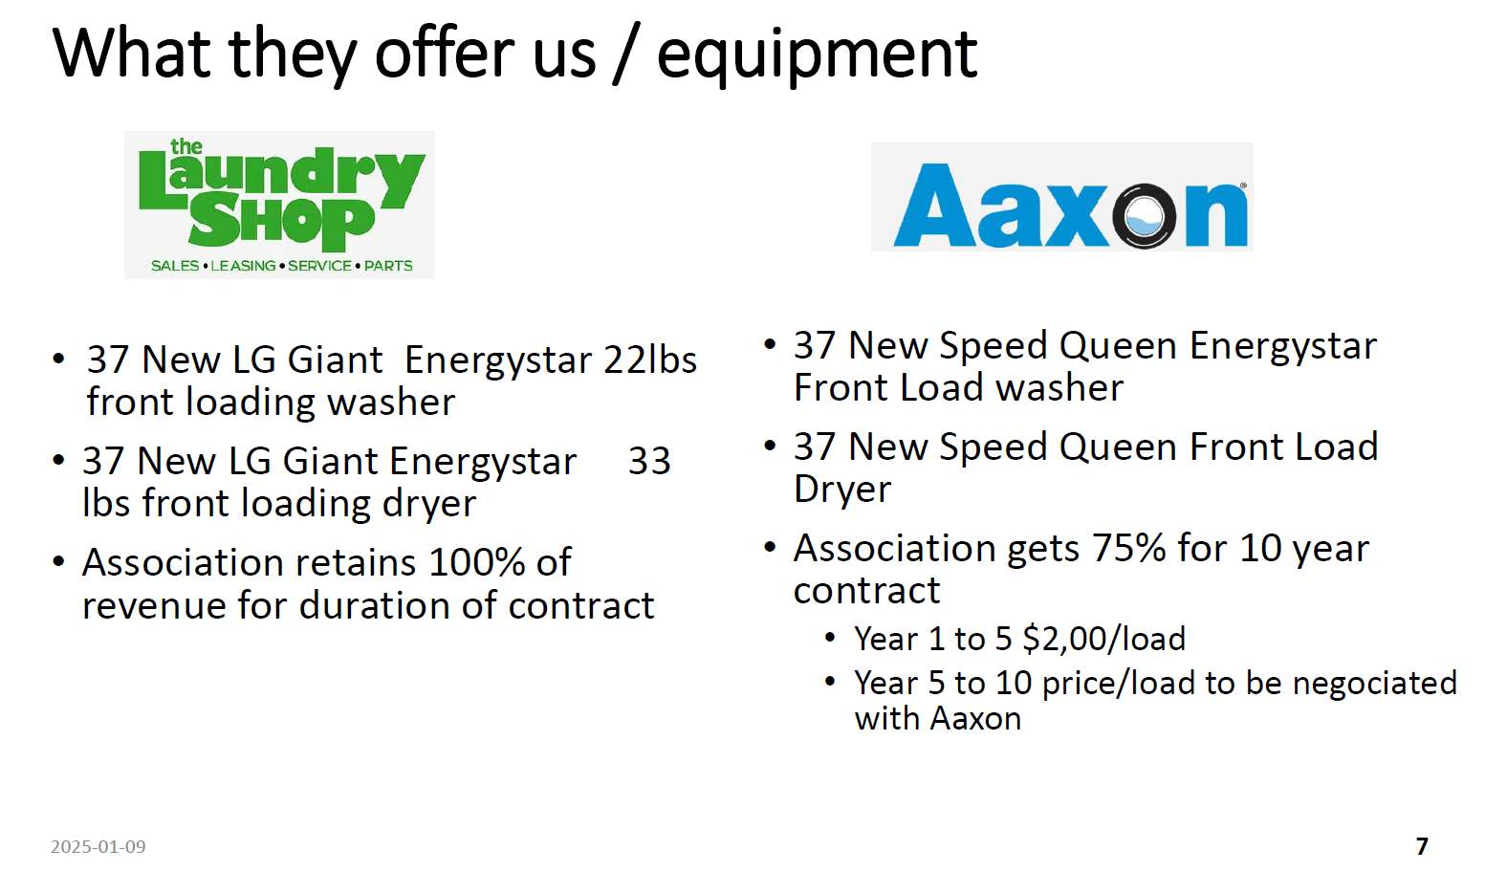

Slide 25
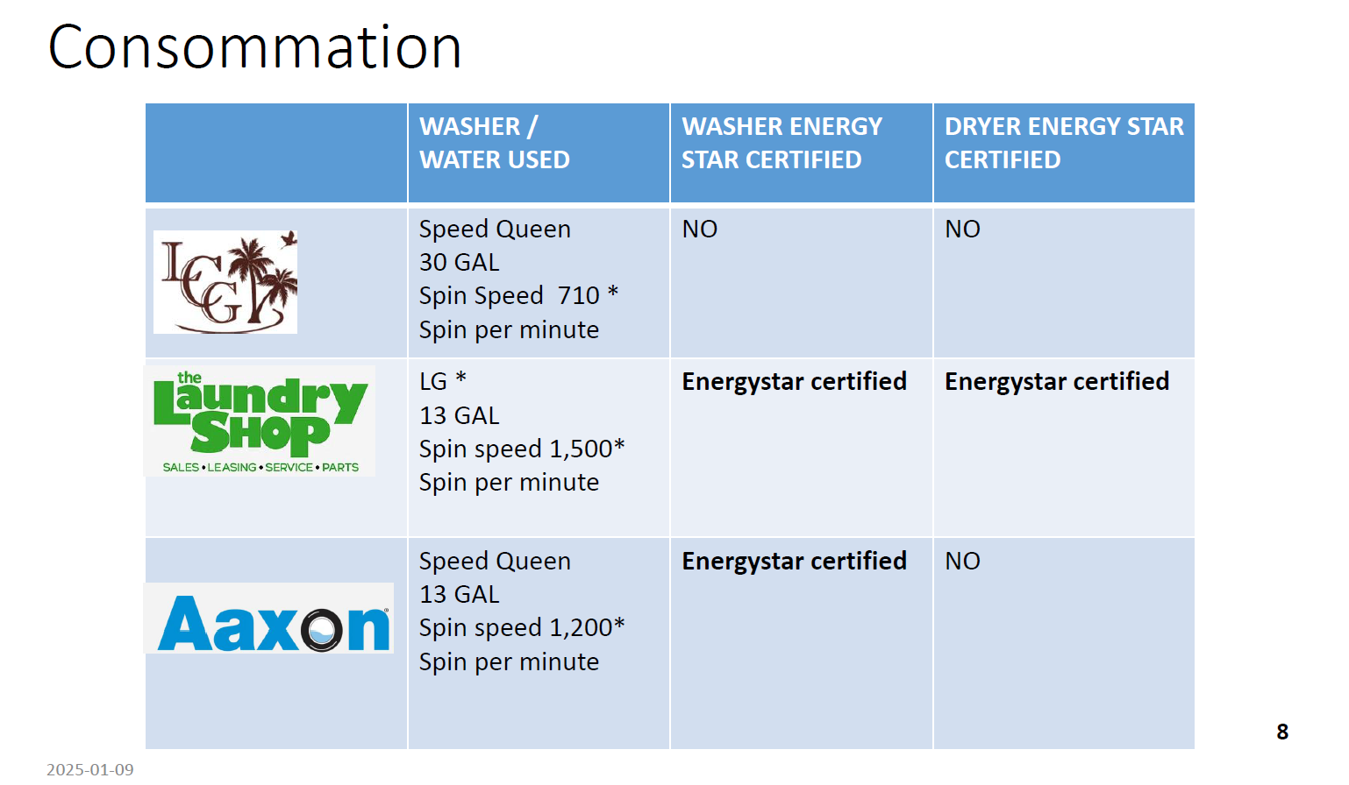

Slide 26
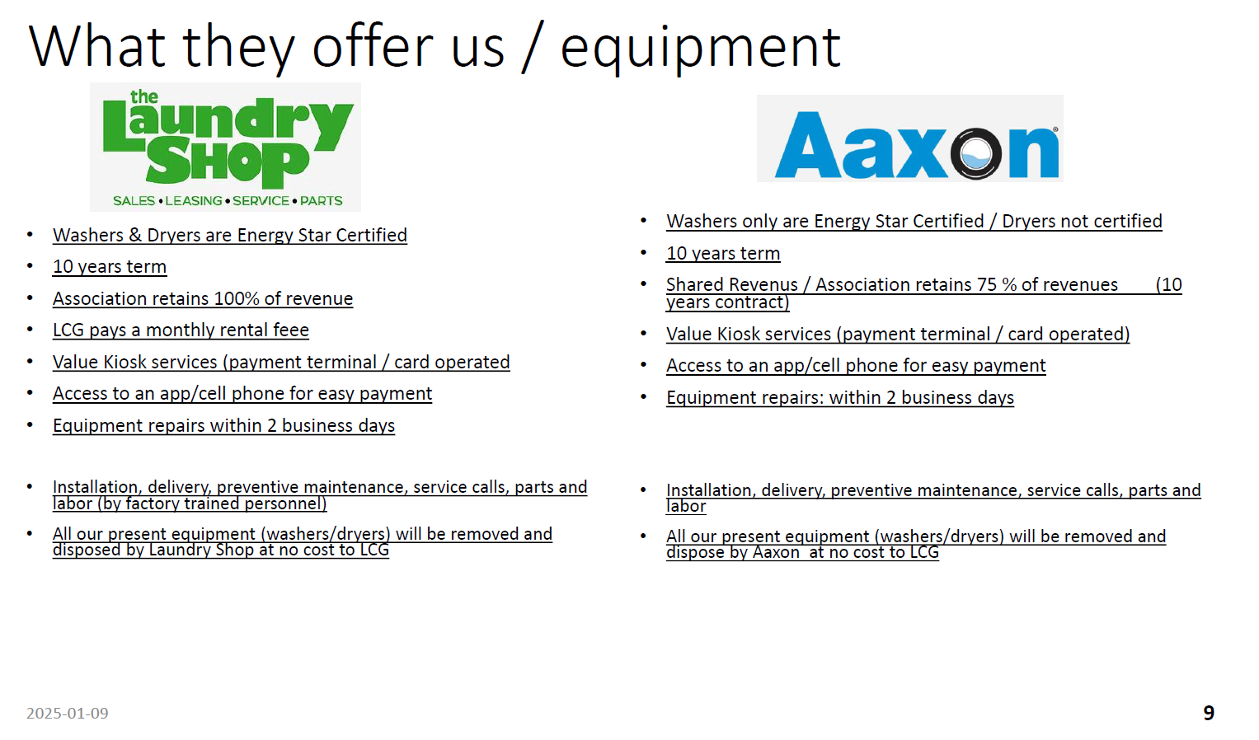

Slide 27


Slide 28
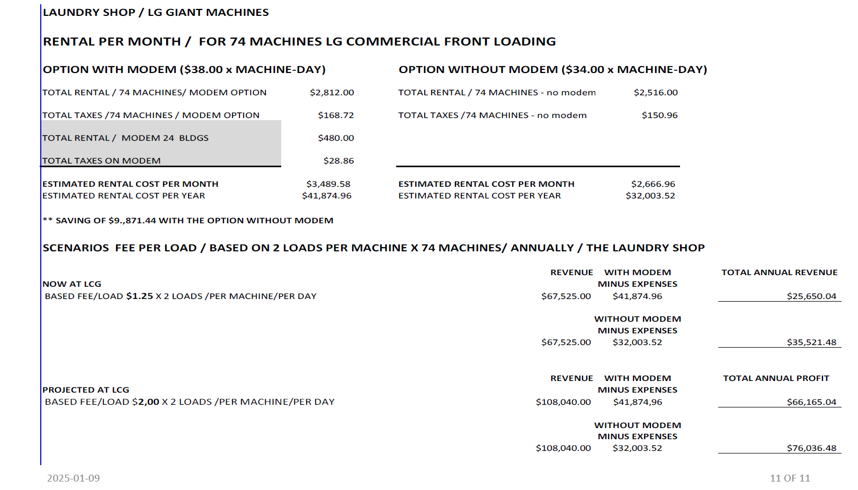

Slide 29


Slide 30
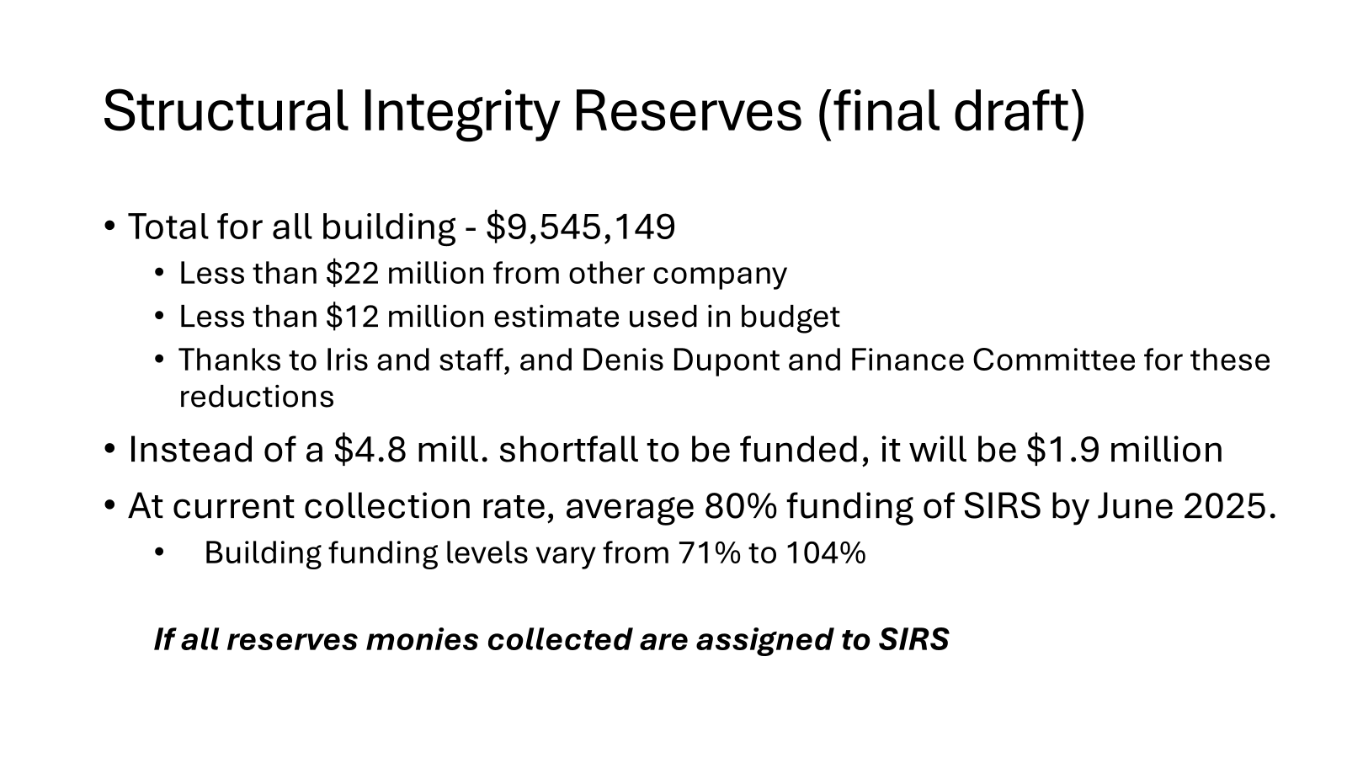

Slide 31
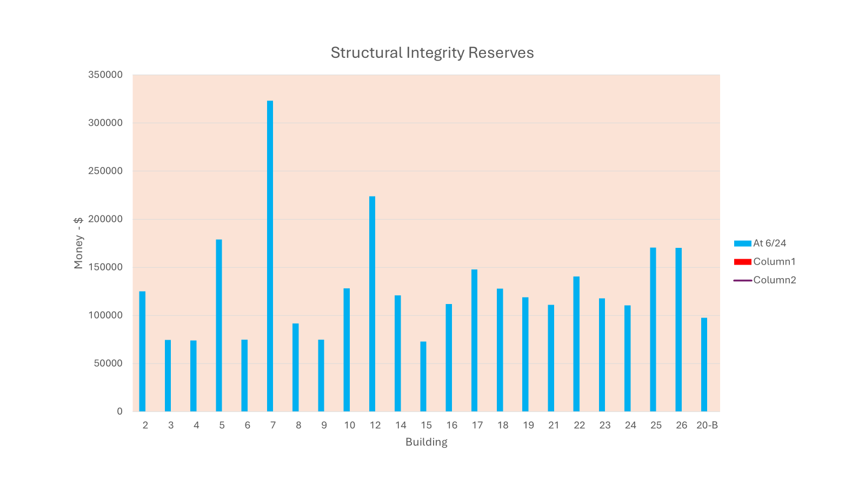

Slide 32
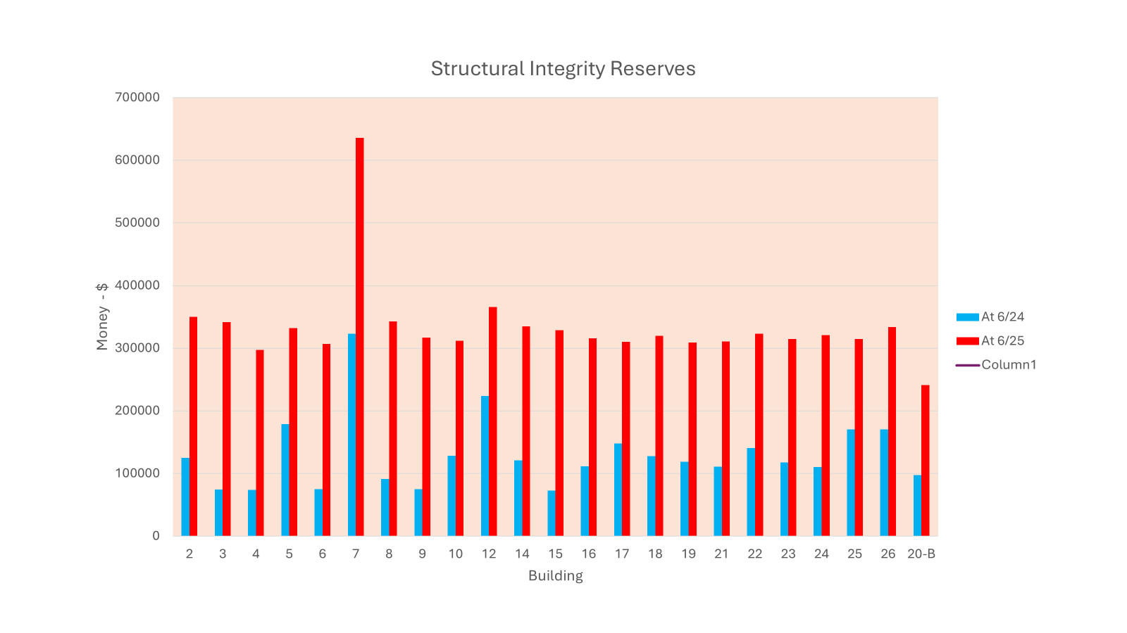

Slide 33
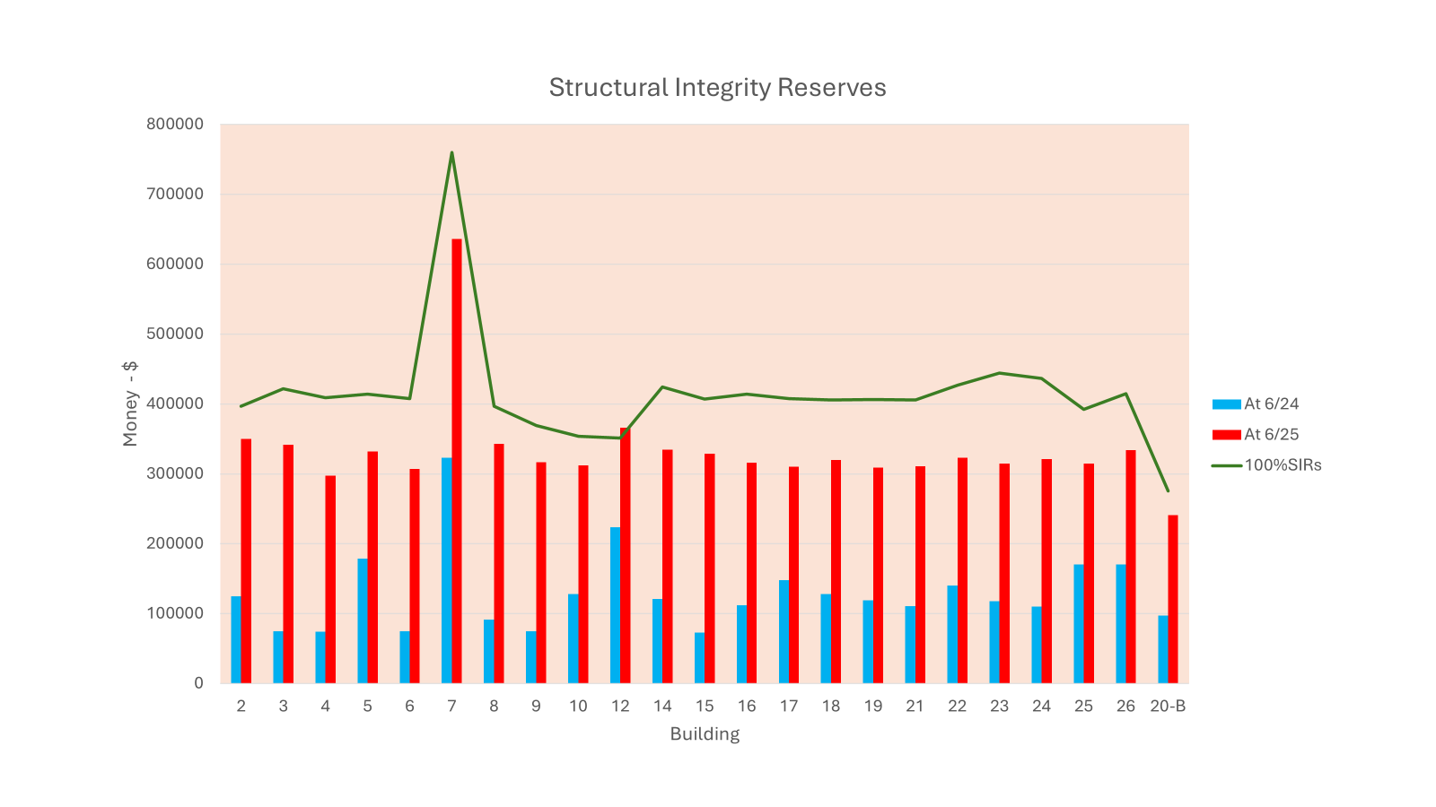

Slide 34
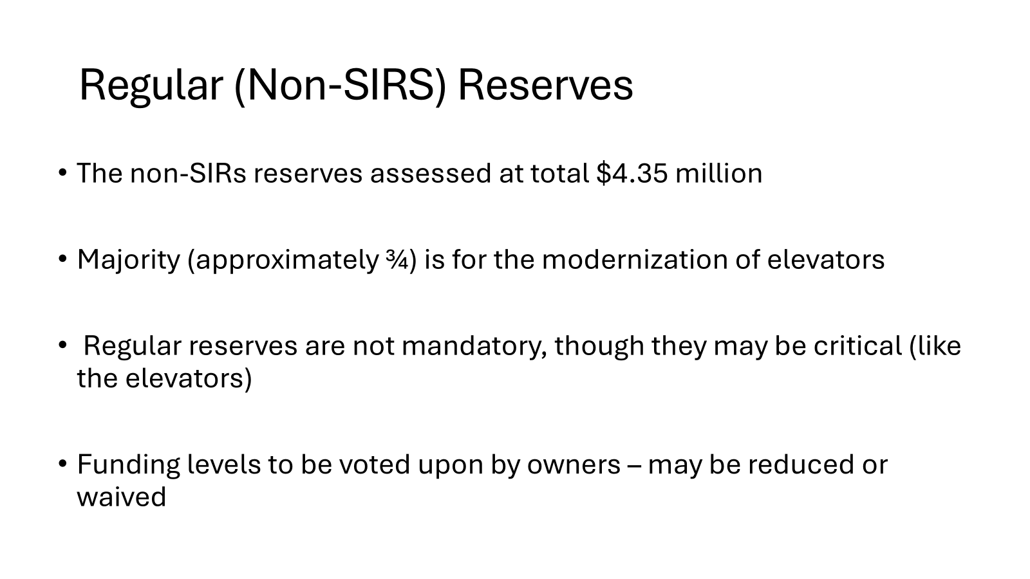

Slide 35
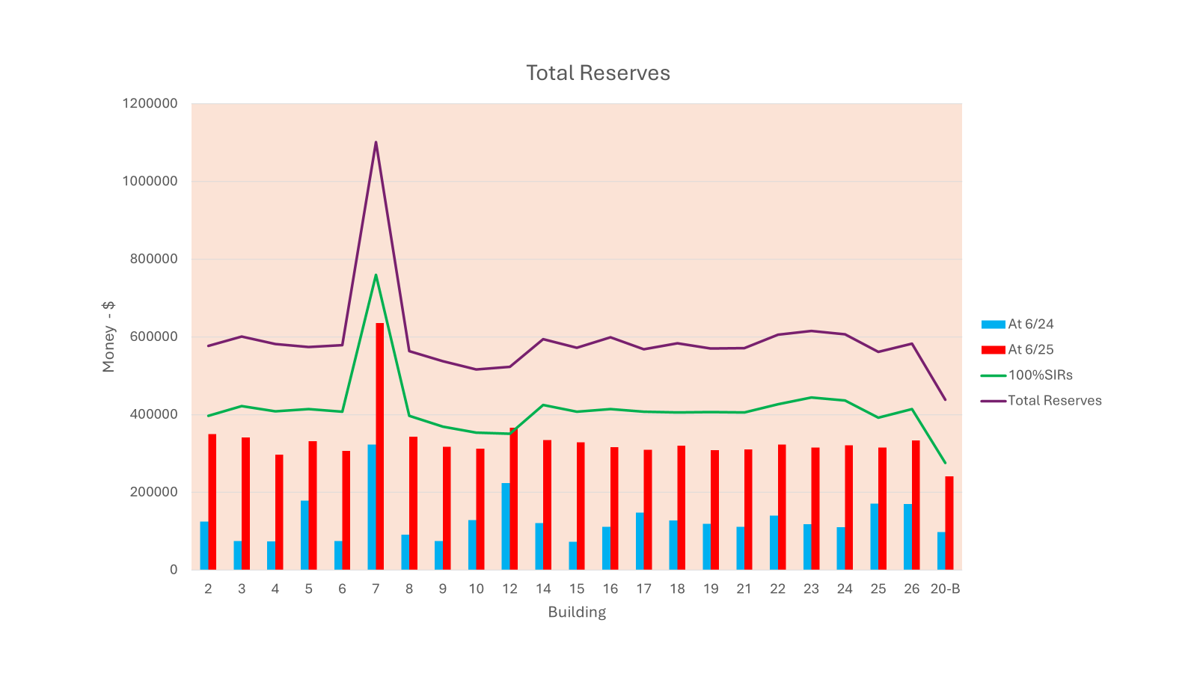

Slide 36
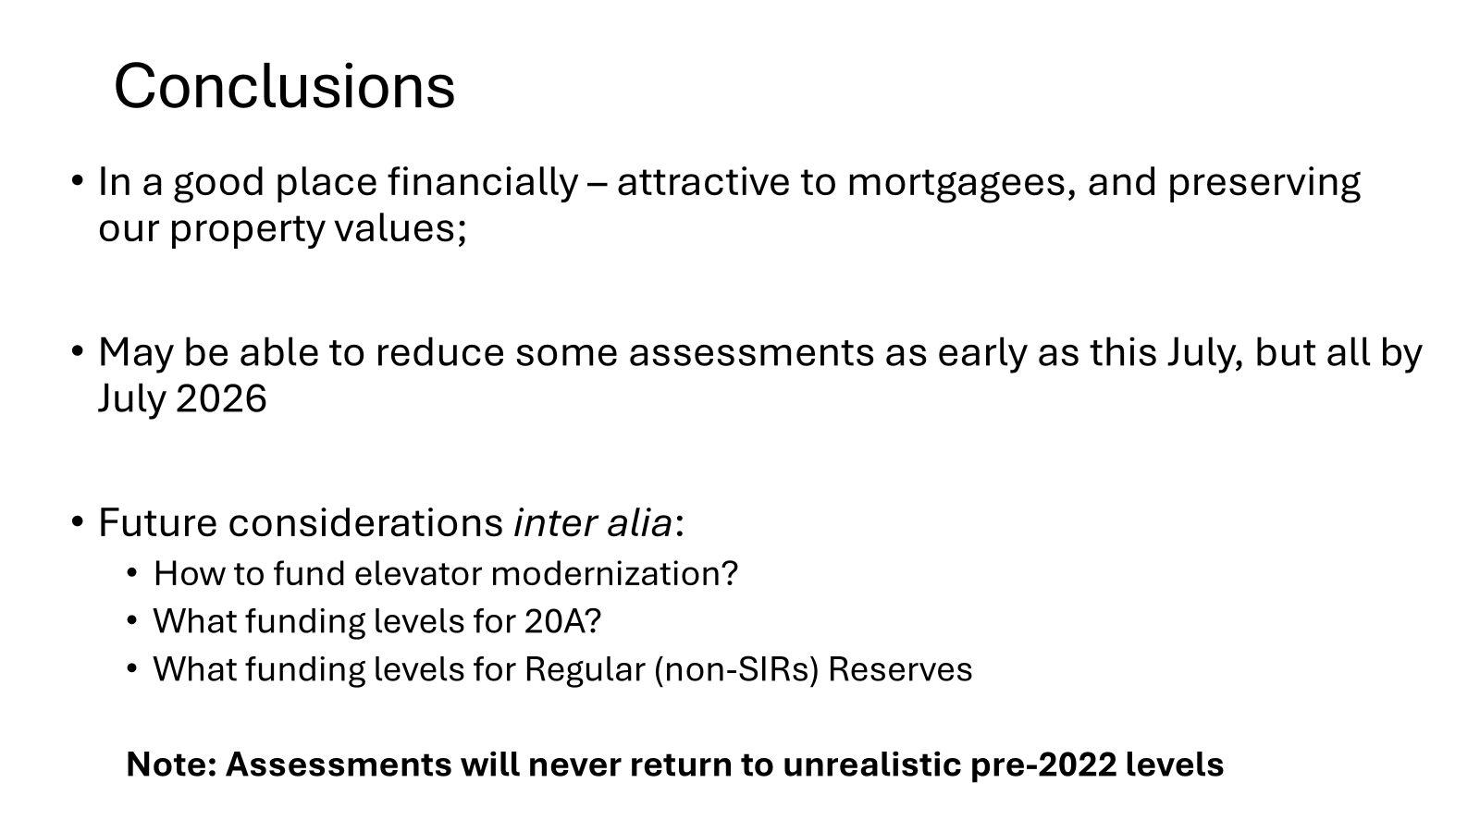

Slide 37


Slide 38
ADJOURNMENT

