Slide 1
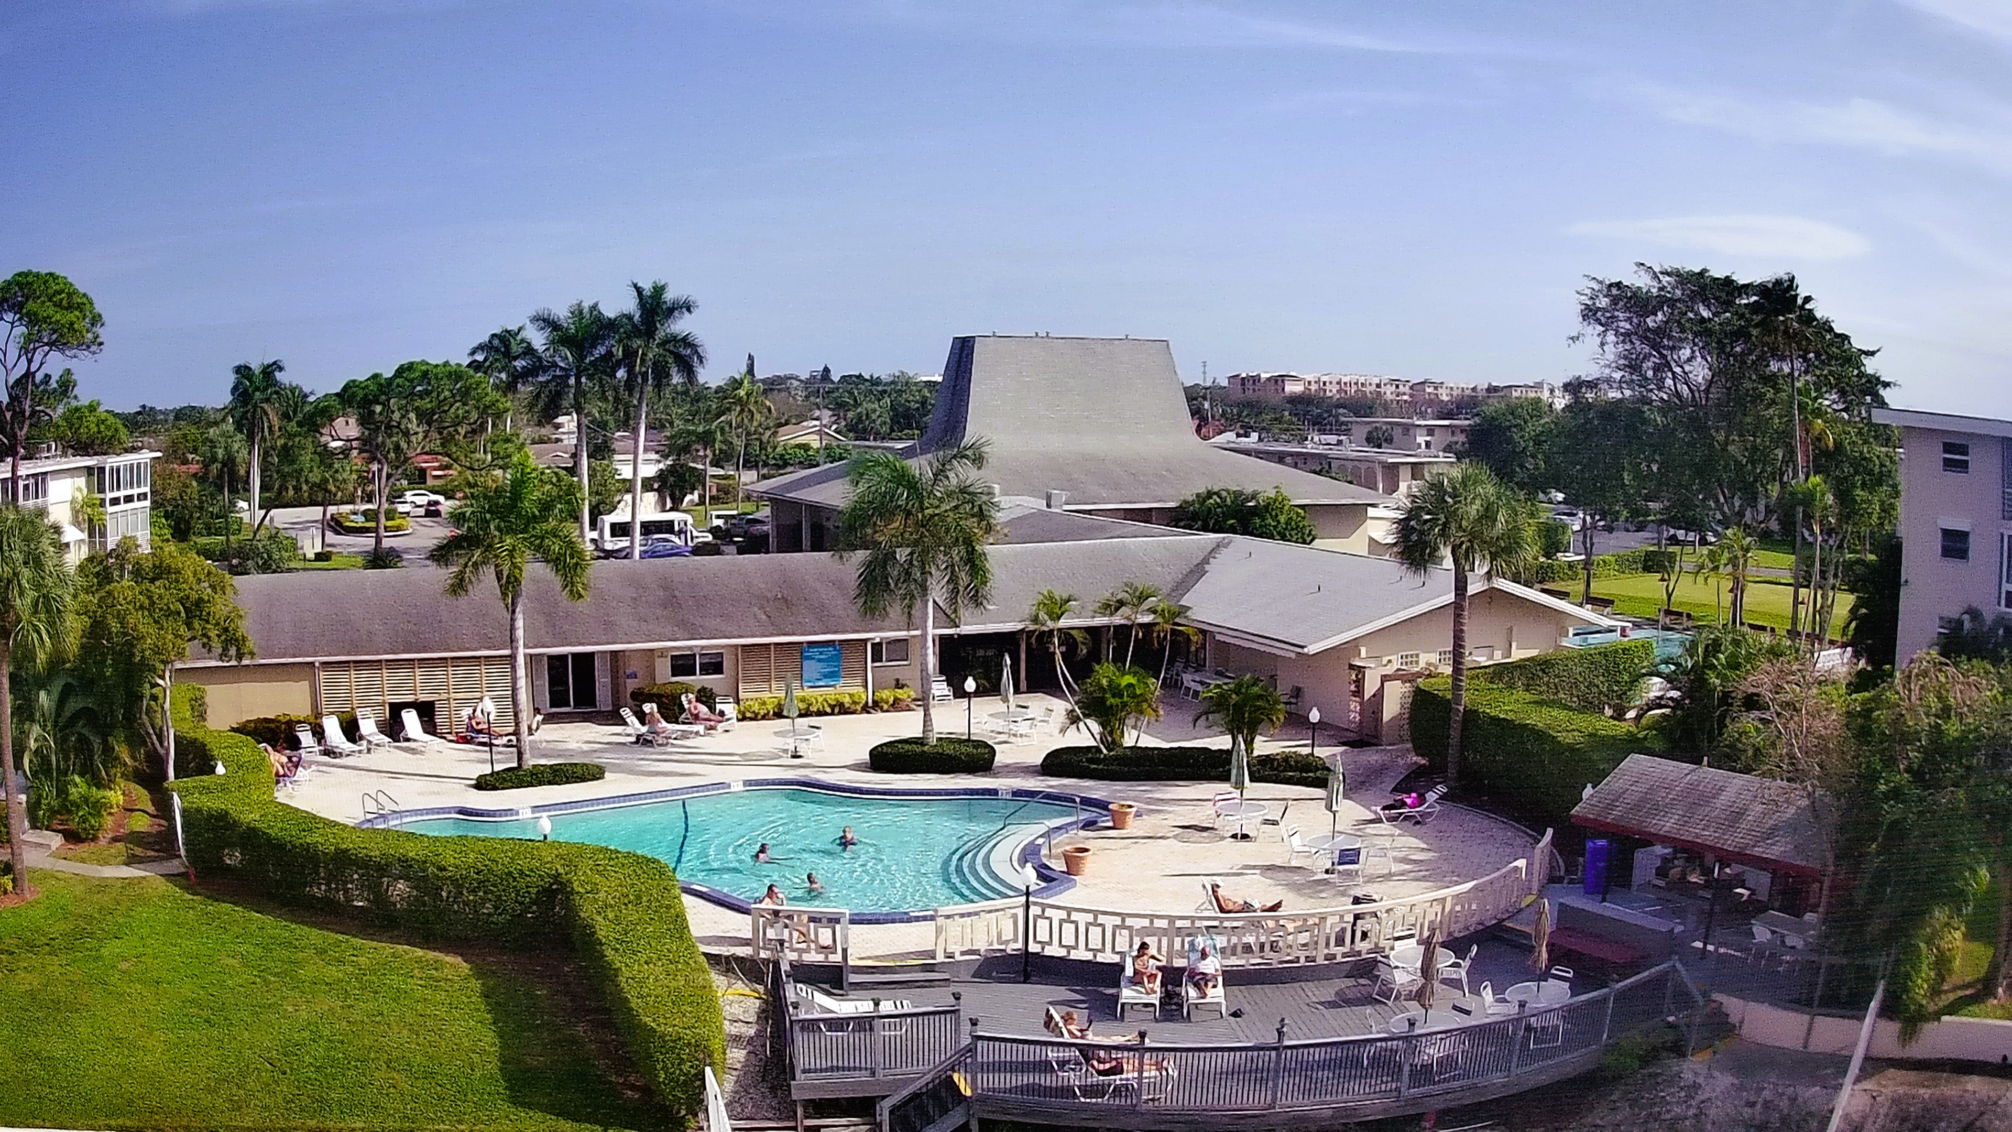
Lake Clarke Gardens Association

Slide 2


Slide 4

TREASURER’S REPORT
September 2024

Slide 6
LCG INCOME/EXPENSE STATEMENT as at September 30, 2024
ACCOUNT NAME | TOTAL 7/1/2024 – 9/30//2024
Revenue Common Area Maintenance Assessments Breezeline/Direct Unit Charge Reserves Assessments (Building & Common) Building Maintenance Assessments Assessments sub-total Other Revenue Adjustments (NSFs etc.) TOTAL REVENUE Expenses Administrative Property Management Insurance Breezeline Other Contract Services Repairs & Maintenance Landscape/Recreation/Pool Utilities Misc. TOTAL EXPENSES NET REVENUE/EXPENSES | 835,145 169,779 1,197,970 291,228 2,494,122 54,391 (427) 2,548,086 52,322 254,633 217,618 123,227 16,494 35,250 35,252 105,998 5,391 846,185 1,701,901
As promised, beneath is the latest Aged Owner’s Report. 83 (nearly 10%) of our units account for almost 90% of the total amount overdue for more than 90 days. Buildings 6, 10, 24, 25 and 20B have the highest delinquency rates. Note that there are still owners who have paid their assessments to Juda Eskew & Associates but who have not yet contacted the office to update their accounts and hence, are still reading as delinquent. The office has sent reminders to all owners to settle/rectify their accounts at the earliest opportunity as collections resume in earnest.

Slide 8
MANAGER’S UPDATE
FRIENDLY LETTER NOTICE
ONSITE PROJECTS
FOUNTAIN
ACH REMINDER
CARD ROOM AC
ARCHITECTURAL APPLICATION

Slide 9
Anne & Lee Bowman
2812 S Garden Drive 206
22-206
Patricia Counterman
2811 S Garden Drive 304
25-304
WILMINGTON SAVINGS FUND SOCIETY, FSB
2581 N Garden Drive 203
2-203
Lake Clarke Gardens
2616 N Garden Drive 107
9-107
Chris & Carmina Petro
2682 S Garden Drive 110
LCG RE-SALE

Slide 10

LCG APPROVED LEASES
AUGUST 15, 2024-September 9, 2024
2991 S. Garden Dr., Unit 103
2615 N. Garden Dr., Unit 308
2616 N. Garden Dr., Unit 111
2615 N. Garden Dr., Unit 111
2811 N. Garden Dr., Unit 209

Slide 11
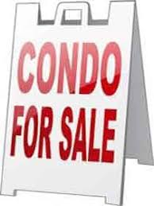
9-107

Slide 12

Is a collective of elevator + escalator professionals innovating the way you build and maintain real estate. Their team will oversee all of your vertical transportation operations, compliance, and test witnessing. From the latest Architectural design trends to implementing the newest safety codes, we are prepared to assure your building gets the service it deserves.

Slide 13


Slide 14


Slide 15
ADJOURNMENT

