Slide 1
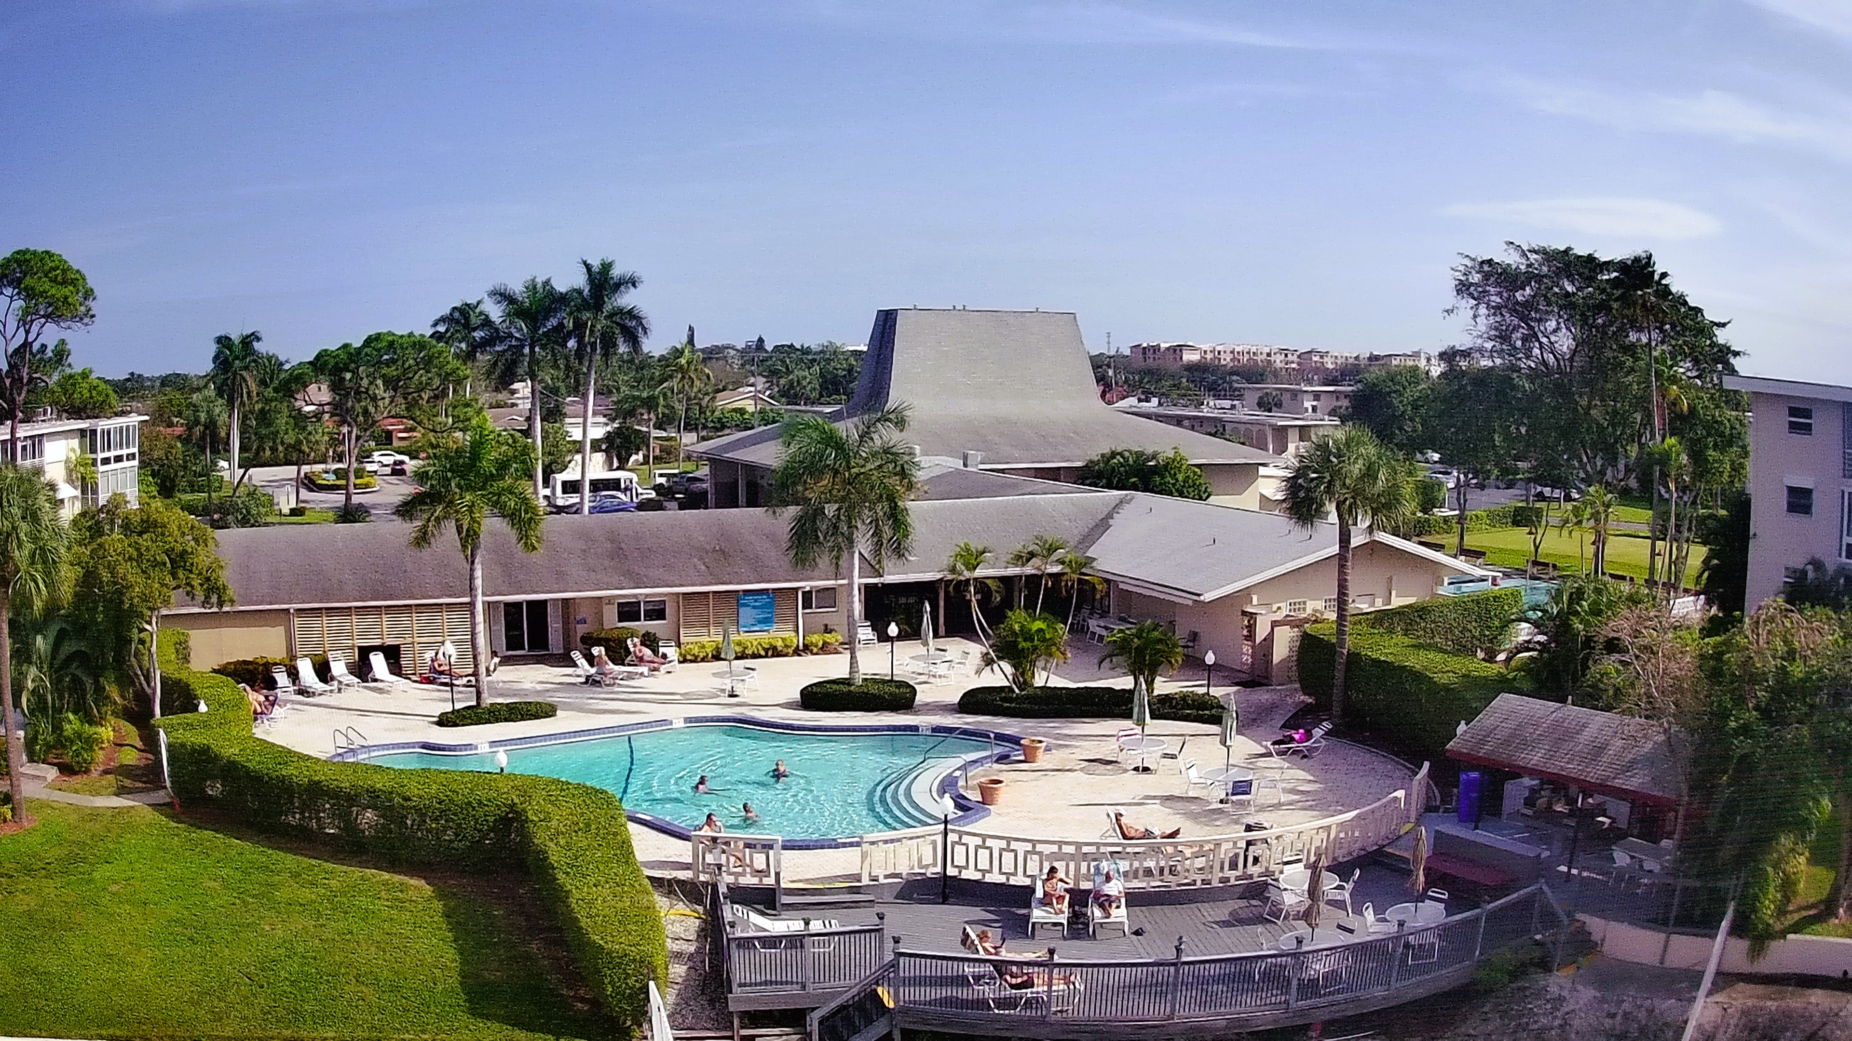
Lake Clarke Gardens Association

Slide 2


Slide 4

TREASURER’S REPORT
January 2025

Slide 5
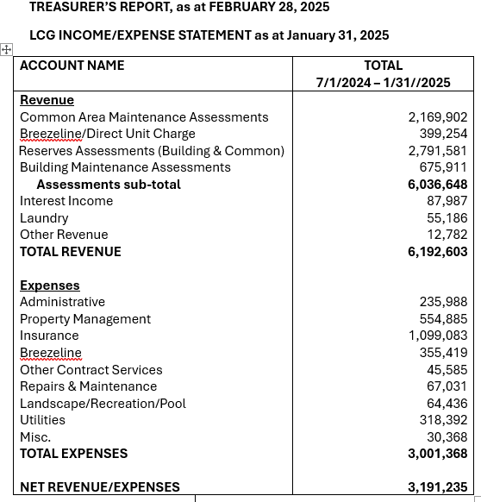

Slide 6
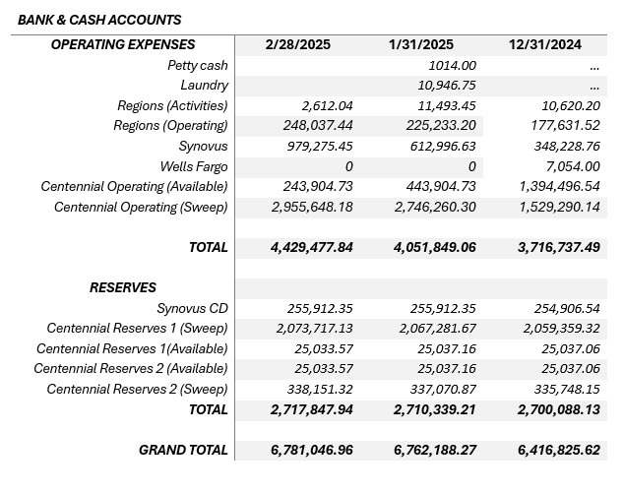

Slide 7
MANAGER’S UPDATE
Website Updates
Townhall
Goals
Financial Reports
Phones
Projects

Slide 8
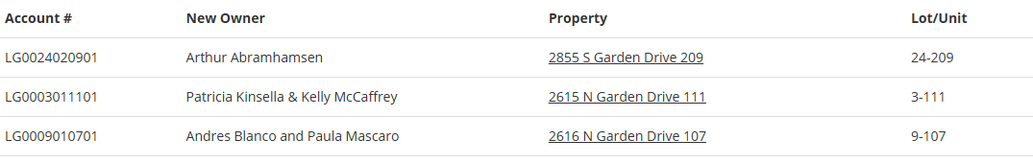
LCG RE-SALE

Slide 9
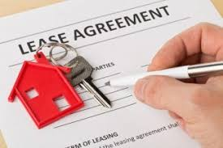
LCG APPROVED LEASES
January 15, 2025-March 7, 2025
5-302
7s-410
8-111
9-210
10-210
12-204
16-203
22-201

Slide 10

COMMITTEE REPORTS

Slide 11

Appointment of Director

Slide 12

Governing Documents
A governing document is a legal document that outlines how an organization is run. It can include a constitution, bylaws, articles of incorporation, and other rules.

Slide 13
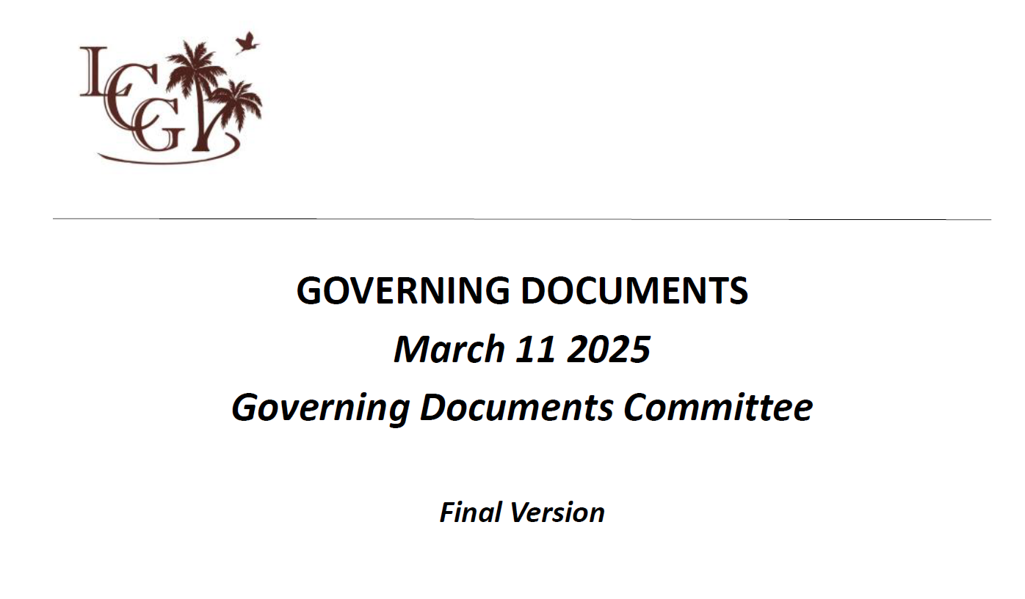

Slide 14
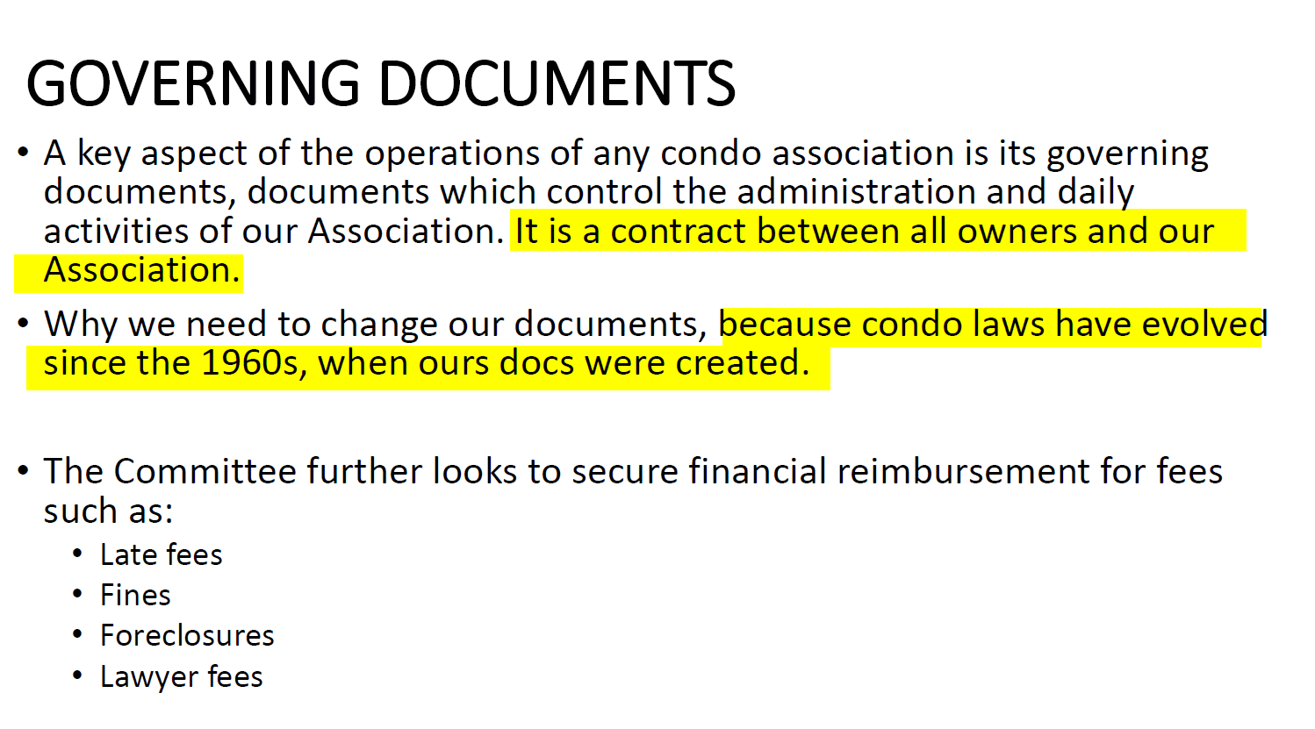

Slide 15
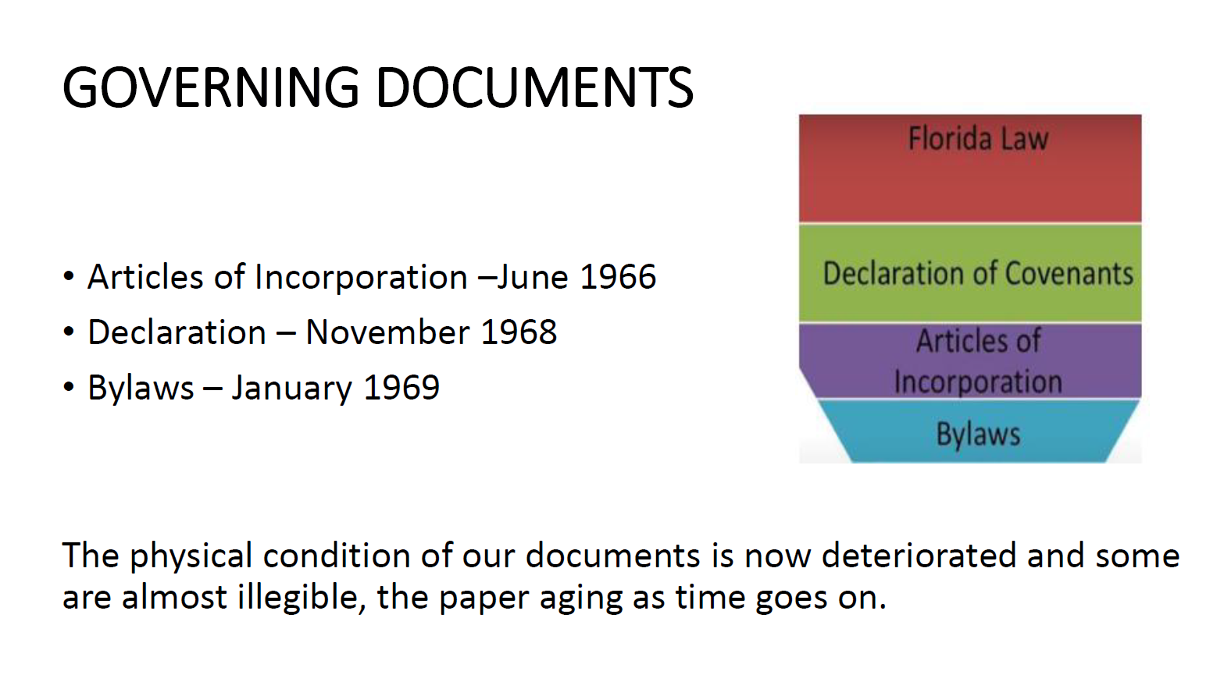

Slide 16
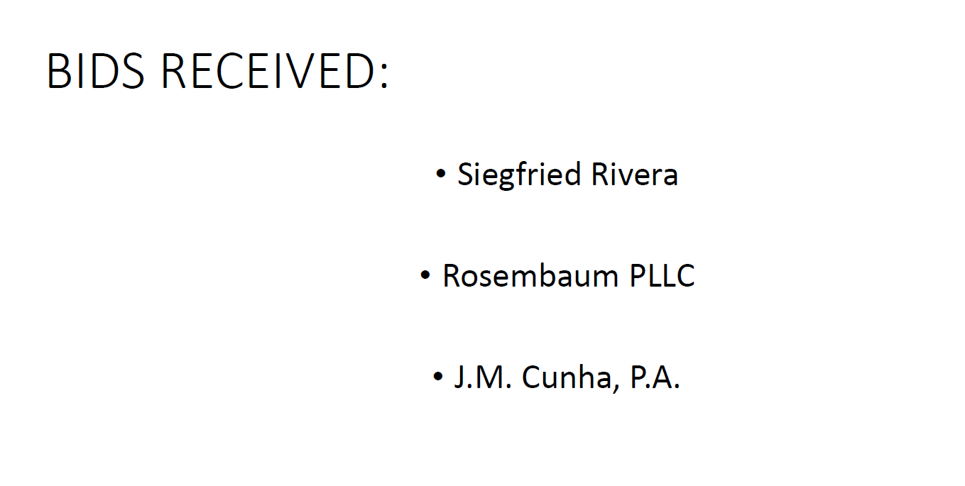

Slide 17
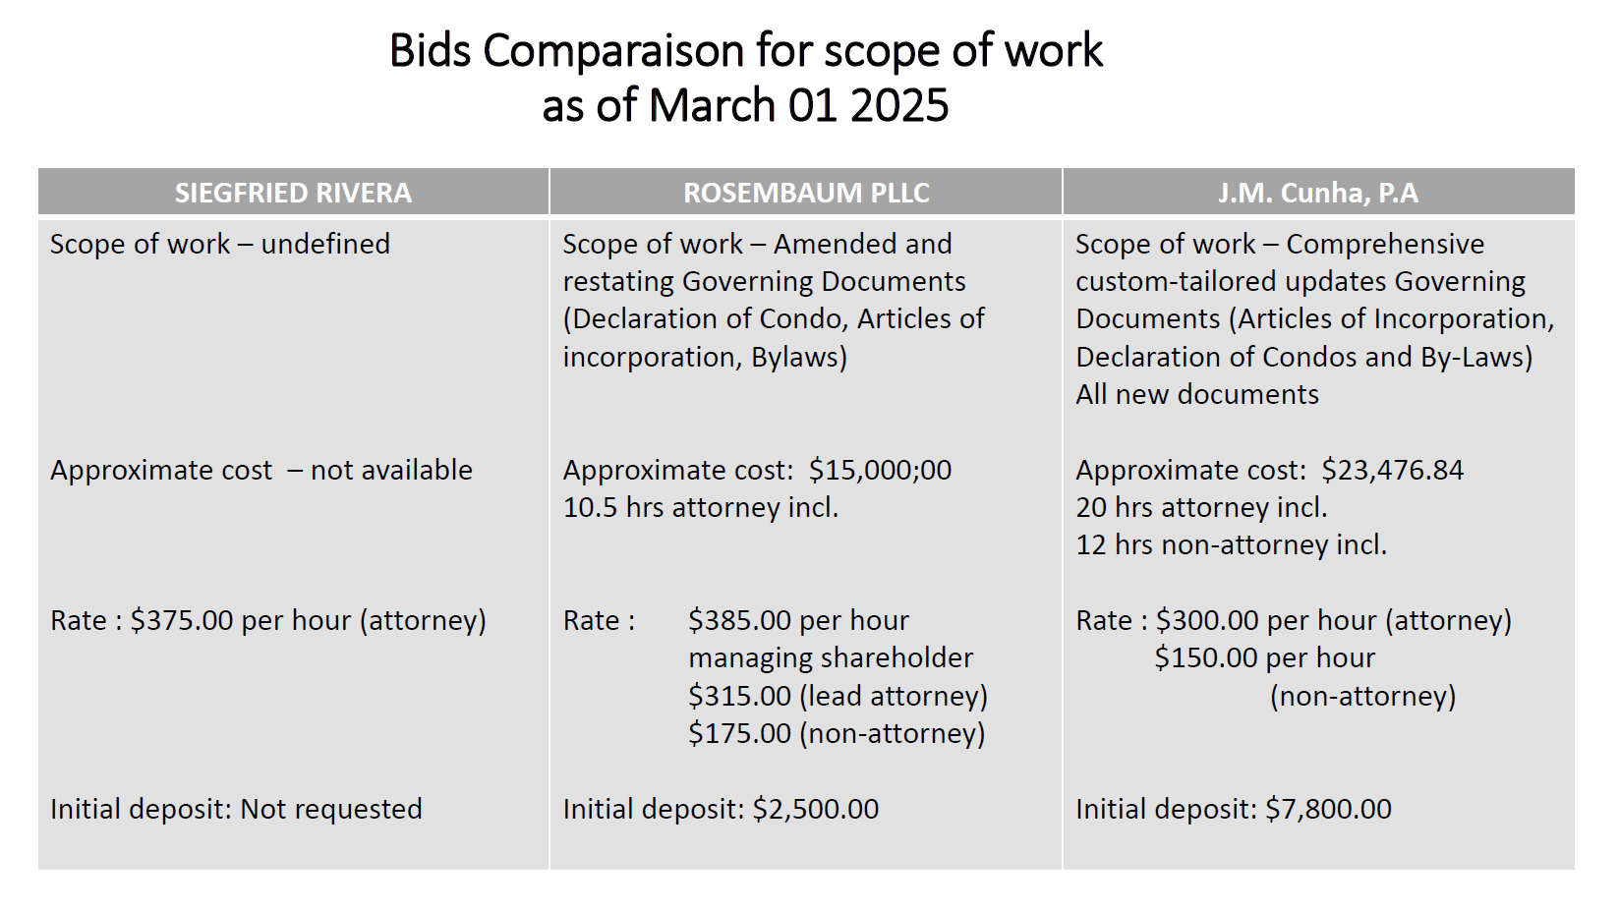

Slide 18
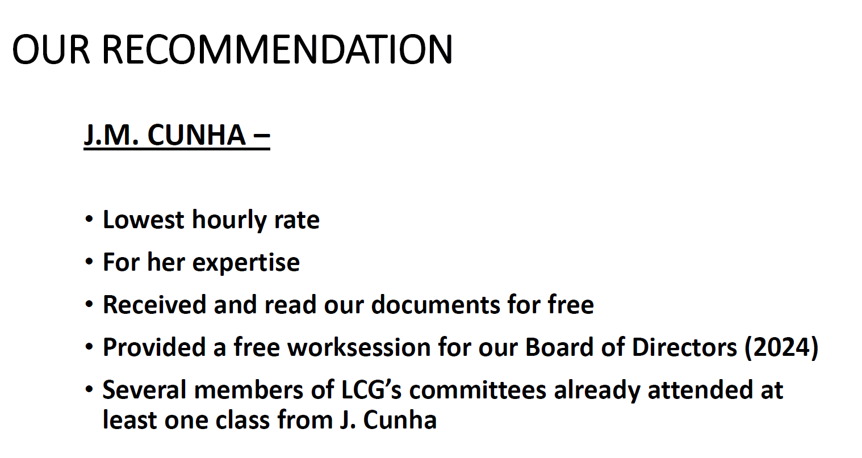

Slide 19


Slide 20

Appointment of the Covenant Committee

Slide 21

Booting Project
Booting a car is a parking enforcement technique that involves attaching a large metal clamp to a vehicle's wheel to prevent it from moving. It's often used instead of towing a car.

Slide 22


Slide 23
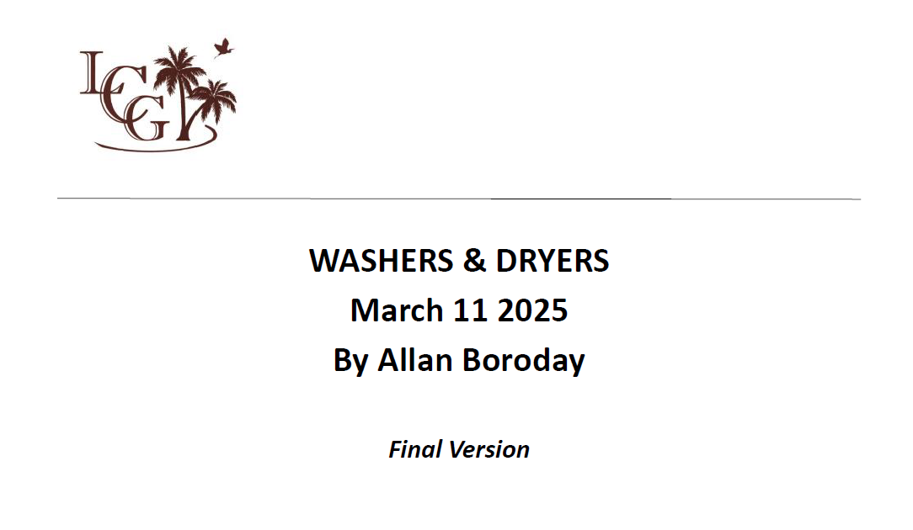

Slide 24
Bids….
•Commercial Laundry Equipment
•Laundry Shop
•Aaxon

Slide 25
WASHERS & DRYERS Situation as of Feb 08,2025
•We met with the three companies and did our due diligence as required.
•We eliminated Commercial Laundry Equipment because they were twice as expensive as Aaxon and Laundry Shop.

Slide 26
First offer: Aaxon
• Aaxon offered a profit-sharing proposal for a duration of 10 years.
• We have no control over the revenues.
• We have no say what so ever money wise.
• They could not offer us a money kiosk that takes cash/debit & credit cards.
• The minimum dollar amount per wash was $2.00 for the first 5 years, to be
negotiated.
• The annual suggested increase was 3% per year.

Slide 27
Second offer: Laundry Shop
• Laundry Shop offered us a complete service rental contract over a
period of 10 years.
• Cost per machine has been negotiated to $32.00 per month per unit plus 7% tax.
• Monthly cost $4,992 and 7% tax of $349.44 for a monthly total of $5,341.44 (for 156 machines) or
$34.24 per machine per month.
• This included contactless smart Card, Laundroworks Combo value adder (money kiosk).
• Accept cash, debit cards and credit cards and also a mobile application to reload your smart card from the convenience of your condo unit.
• Bldg 7 will be receiving four additional stackable 4 washers and 4 dryers, solving a long time
complaint of not enough washers and dryers.
A similar quote in September 2022 was presented by the Long Range
Planning Committee with a price of $42.00 per month per machine
for a 10 years rental contract .
In January 2025, we managed to reduce the cost by $10.00 per
machine per month , a saving of $1,669.20 monthly X 12 months =
$20,030.40 annually

Slide 28
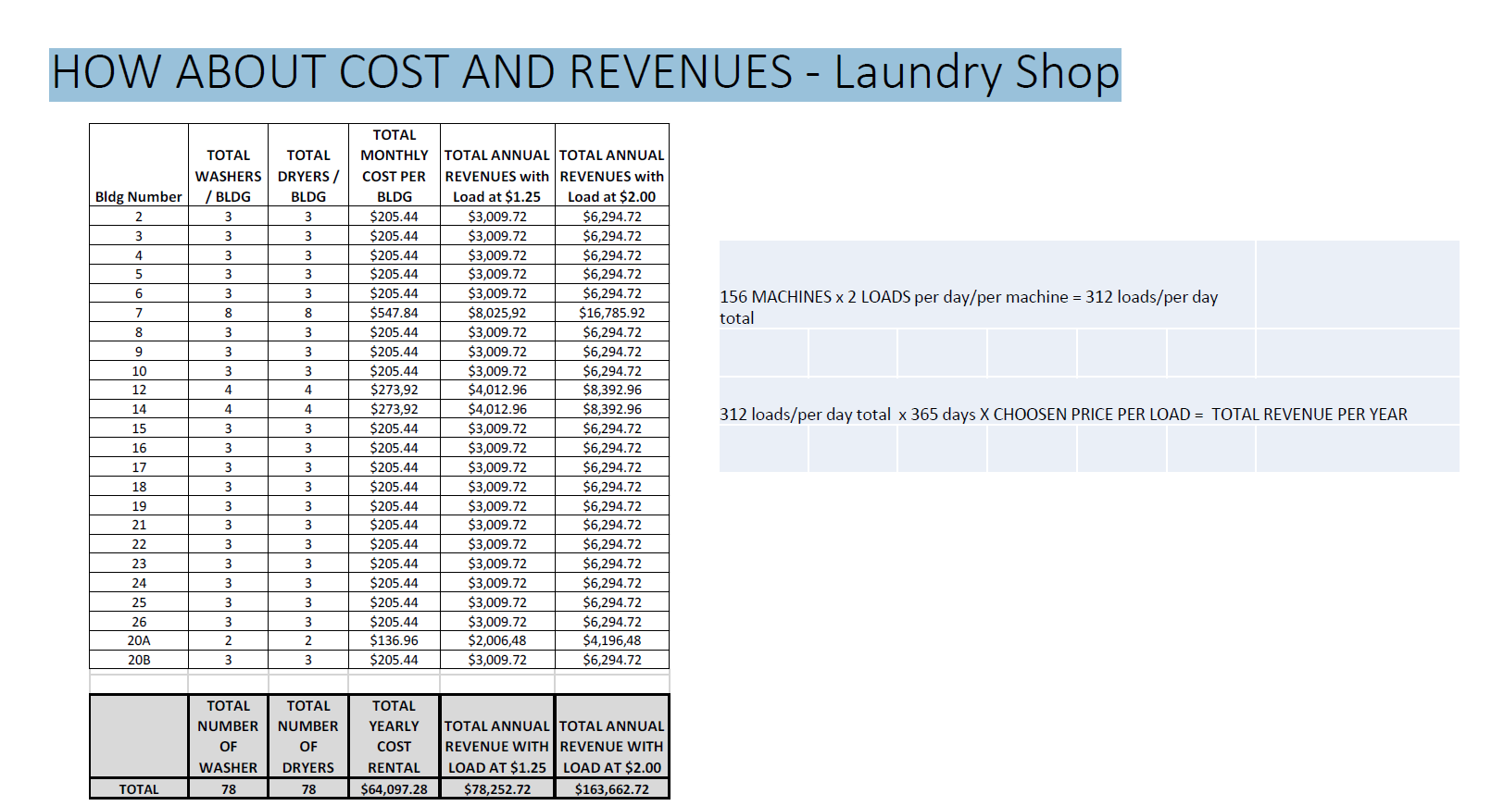

Slide 29
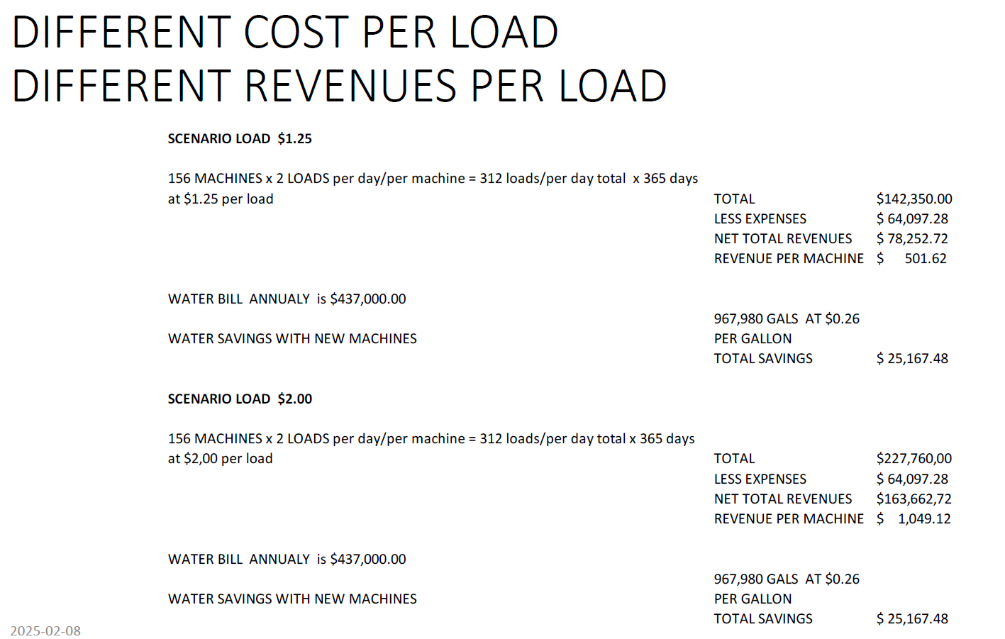

Slide 30
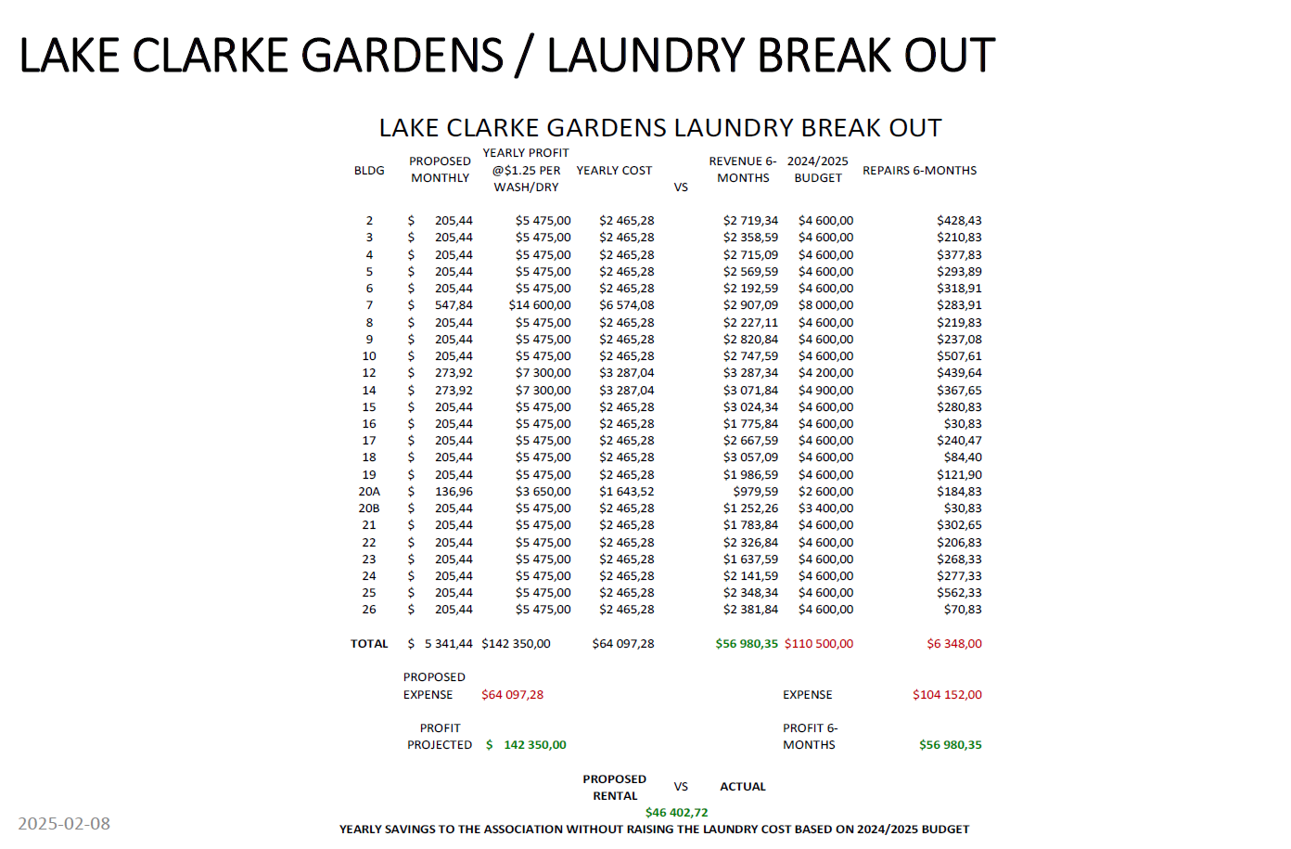

Slide 31
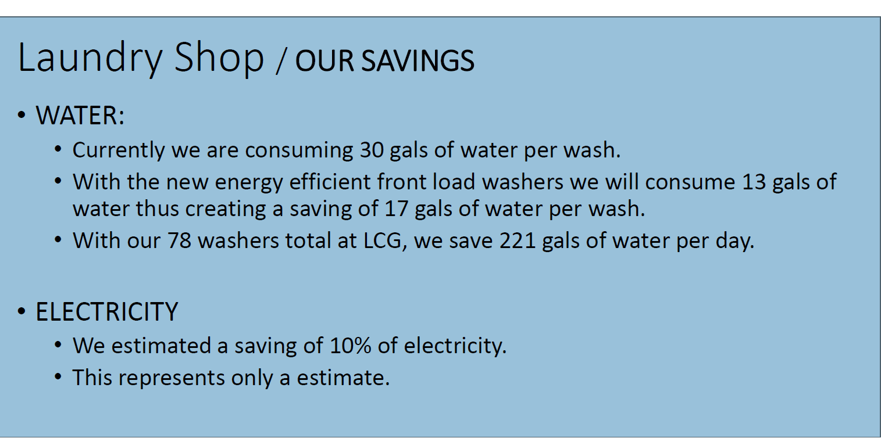

Slide 32
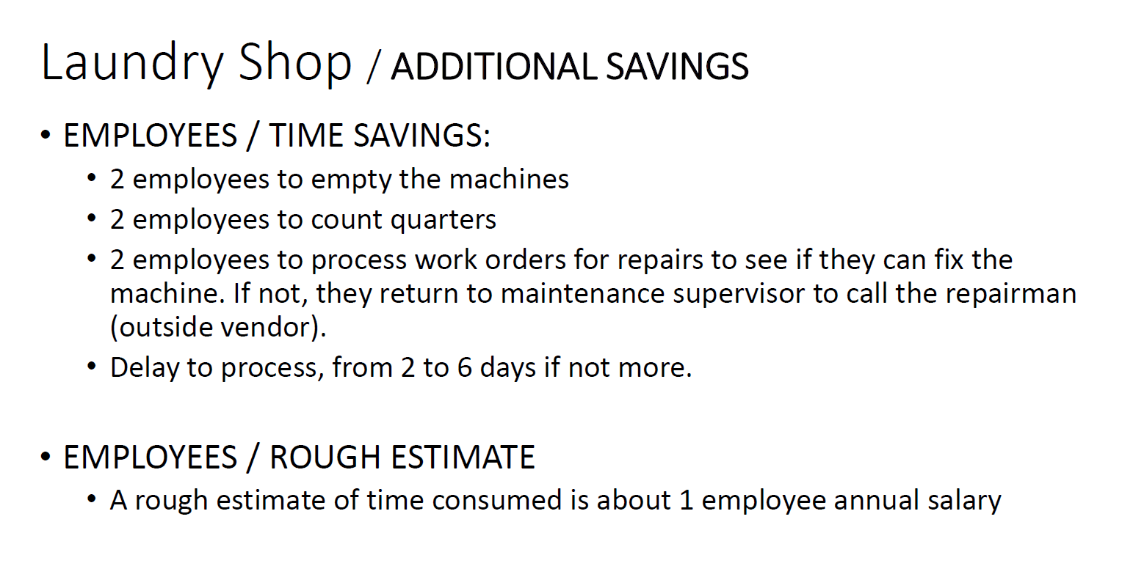

Slide 33
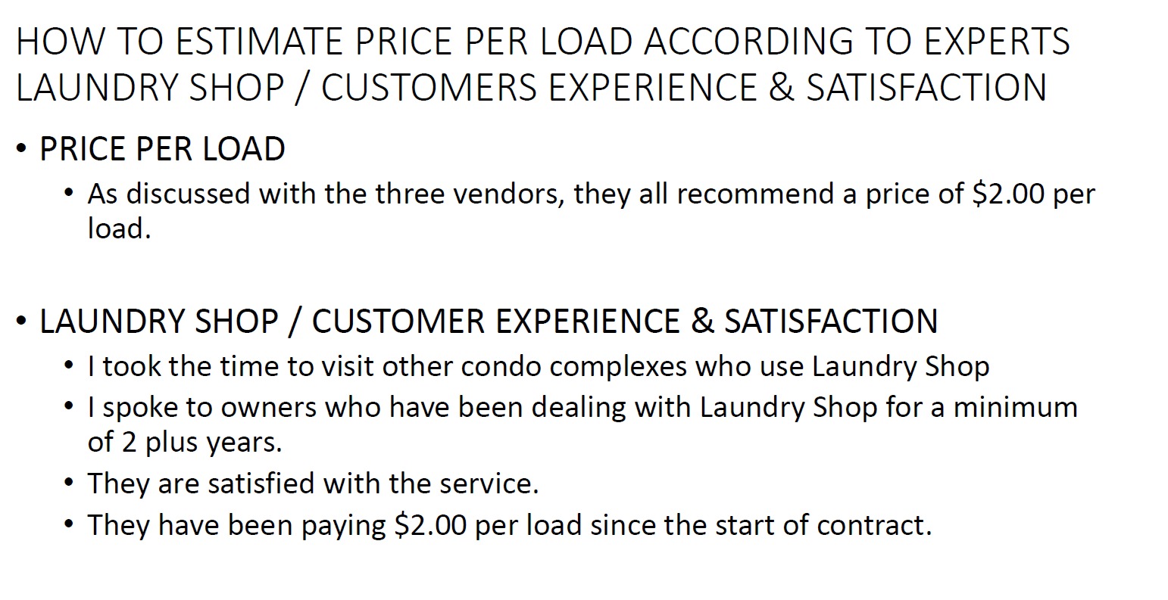

Slide 34
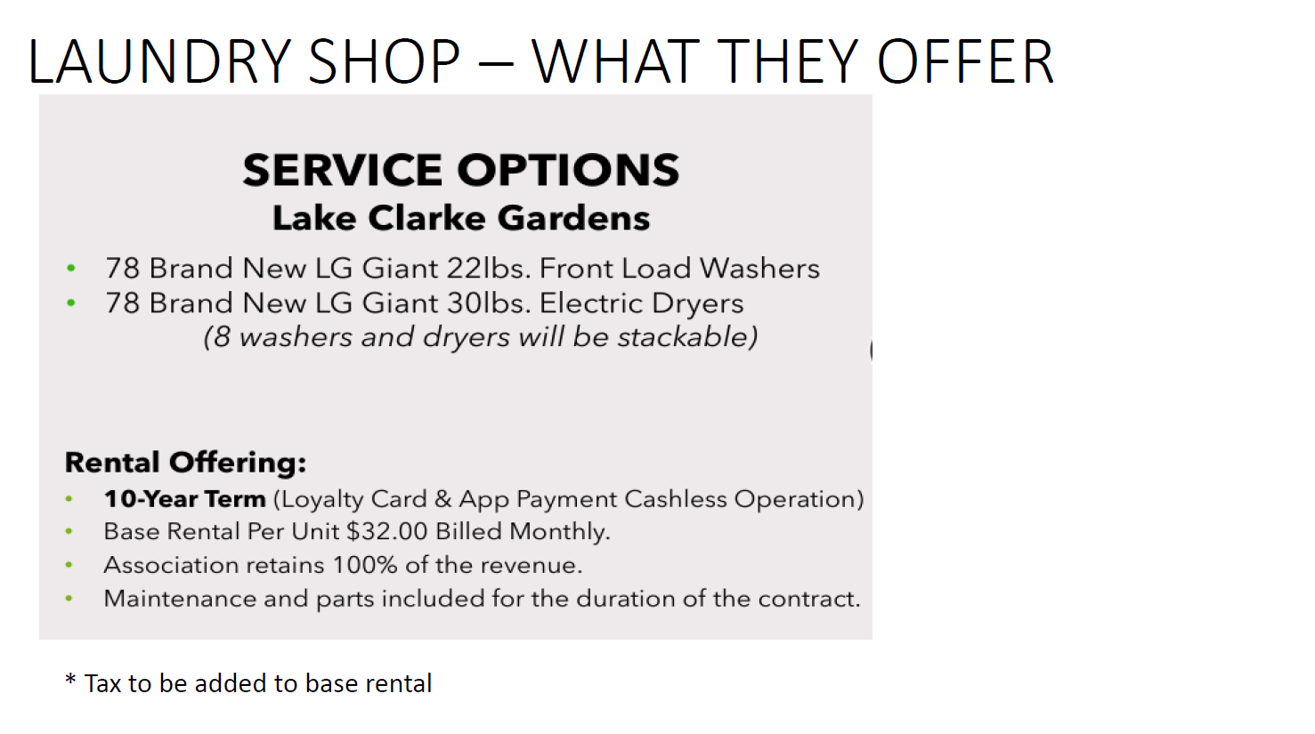

Slide 35
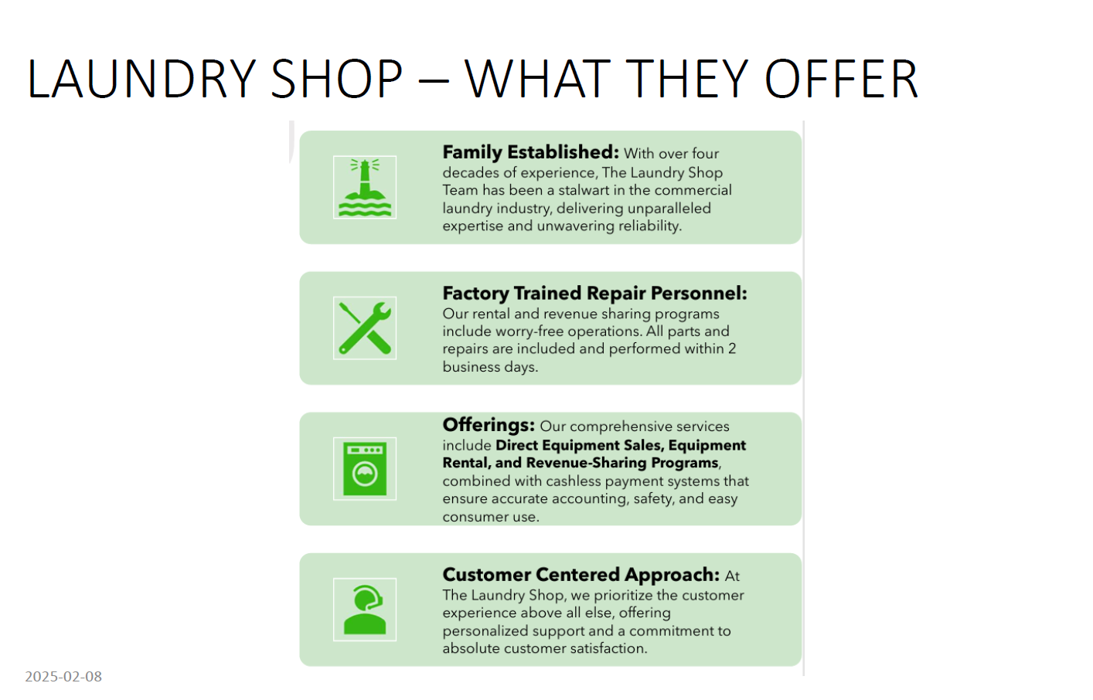

Slide 36
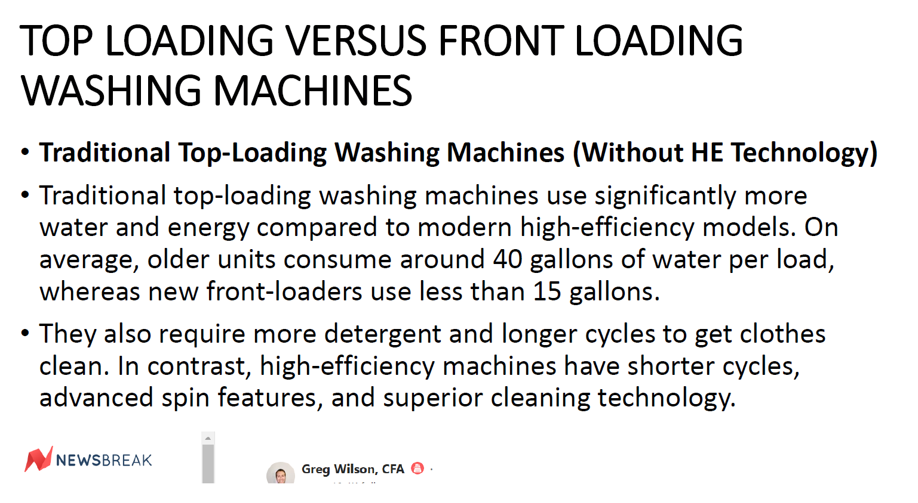

Slide 37


Slide 38
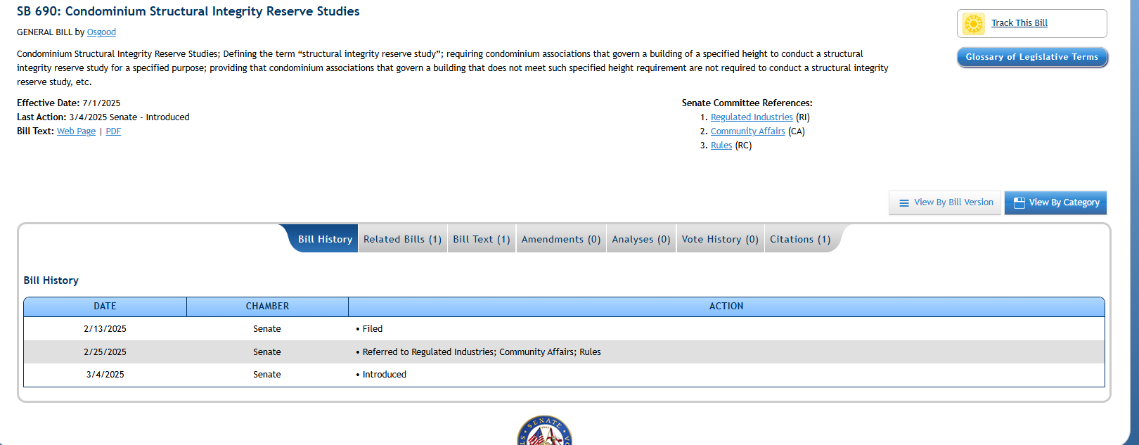
SIRS UPDATE
All final corrections have been submitted to Association Reserves
The general reserve fund will now become the SIRS Reserve as of July 1, 2025
Current Bill:

Slide 39

Maximum of three items per unit per week
Contact the office for scheduling
Office will open the bulk area

Slide 40


Slide 41
ADJOURNMENT

